Slide 1
Scientific Method

Slide 2
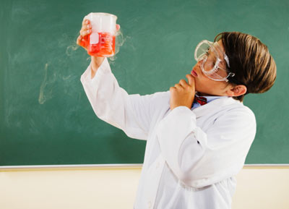
What is the Scientific Method?
It is a process that is used to find answers to questions about the world around us.

Slide 3
Is there only one “scientific method”?
No, there are several versions of the scientific method.
Some versions have more steps, while others may have only a few.

Slide 4
Similarities in the Scientific Method
They all begin with the identification of a problem or a question to be answered based on observations of the world around us and provide an organized method for conducting and analyzing an experiment.

Slide 5
What is a hypothesis?
It is a PREDICTION based on observations and your research of the topic.
It is an “If/then statement”
It is NOT A GUESS!!!!!!!!

Slide 6
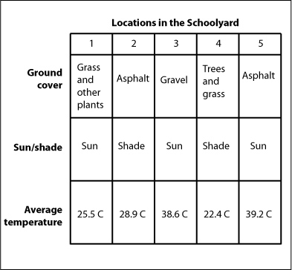
What is data?
It is information gathered during an experiment.
What are some examples of data we could collect?

Slide 7
Identify the Problem
What do you want to know or explain? Use observations you have made to write a question that addresses the problem or topic you want to investigate.
Example: What causes the bubbles on aquatic plants to form?

Slide 8
Form a Hypothesis
A hypothesis is an IF/THEN statement
What do you think will happen? Predict the answer to your question or the outcome of the experiment.

Slide 9
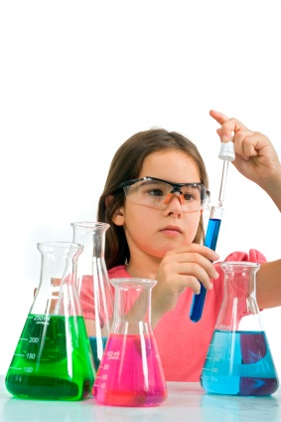
Create an Experiment
How will you test your hypothesis?
Develop a procedure for a reliable experiment and address safety rules.
Identify constants, variables (dependent & Independent), and the control.
Construct a table to record your data.

Slide 10
Constants
These are the factors that will remain the same in each part of the experiment.
Examples: water temperature, amount of water, plant species, number of leaves, size of plant, pH of water, duration of light, light intensity.

Slide 11
Variables
Independent Variable – The factor that you select, that will change with each experiment.
Example: color of light (wavelength)
Always on the X-axis of a graph
Dependent Variable – data that you collect (what you measure or count in an experiment).
Example: number of bubbles produced
Always on the Y-axis of a graph

Slide 12
Control
The standard or baseline experiment – it is what you compare your other experiments to.
Example: plants exposed to sunlight (white light)

Slide 13
Perform an Experiment
Follow the steps in your procedure to perform your experiment.
Record data (in your table) and make general observations.
Make sure to include units!!!

Slide 14
Communicate the Results
Graph the data. Make sure to include all labels and units.
Write an analysis which summarizes your results and state how reliable your results are.
Write a conclusion that discusses the weaknesses of the experiment, and how the experiment could be improved. Also include any questions that may come up from your experiment that you could also test.

