Slide 1
Phylum Porifera

Slide 2
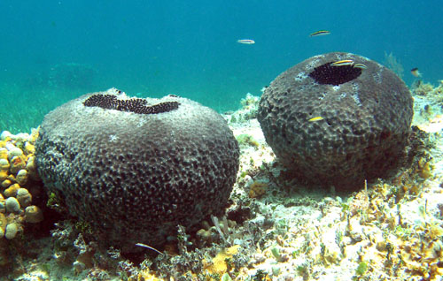
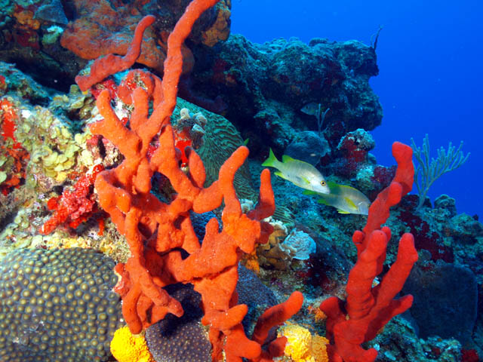
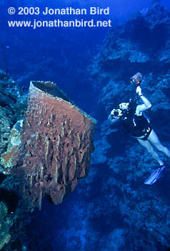
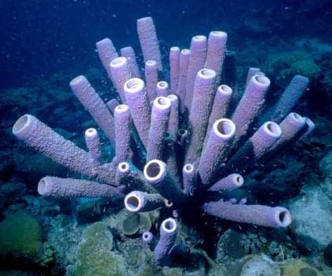

Slide 3
Questions
Sponges are animals so what domain are they in?
What kingdom?

Slide 4
What does Porifera mean?
Porifera literally means “pore bearing”
They were named this because they have pores (tiny openings) all over their bodies

Slide 5
Sponges
Sponges are sessile (live their entire adult life attached to a single spot.

Slide 6
Sponge Body Plan
Sponges are asymmetrical (without symmetry)

Slide 7
Questions
What does Porifera mean?
What type of symmetry do sponges have?
Do sponges move in their adult life?

Slide 8
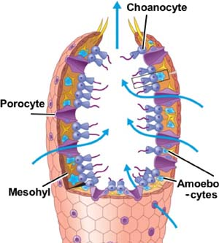
Pore Cells
This is where the water comes through – these cells are why sponges are in the phylum Porifera

Slide 9
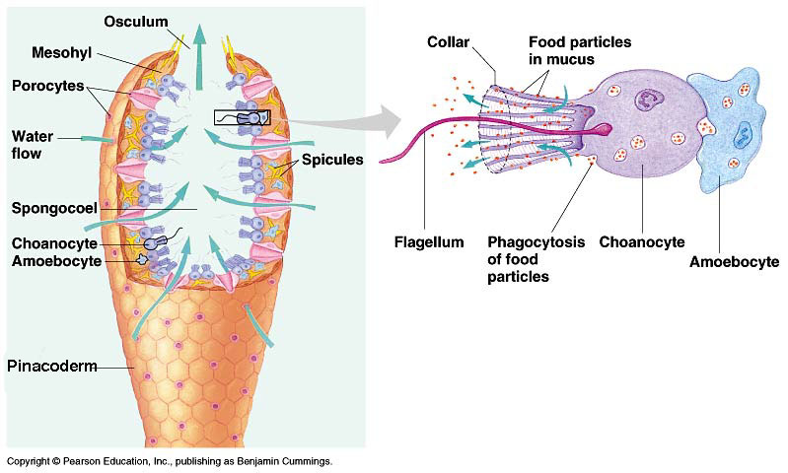
Choanocytes/Collar Cells

Slide 10
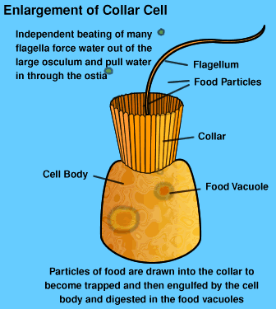
Choanocytes/Collar Cells
These are specialized cells that have flagella to move a steady current of water through the sponge

Slide 11
Gelatinous Layer/Mesohyl
Middle layer – where archaeocytes and spicules are located

Slide 12
Amoeboid Cells/Archaeocytes
Specialized cells that move around within the walls of the sponge

Slide 13
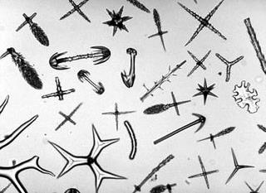
Spicule
Part of the sponge’s simple skeleton
Made of either calcium carbonate or silica
“Hard sponges” have them

Slide 14
Soft Sponges
Soft sponges have spongin which is made of flexible protein fibers.
ie bath sponges

Slide 15
Spongocoel
The hollow body of the sponge

Slide 16
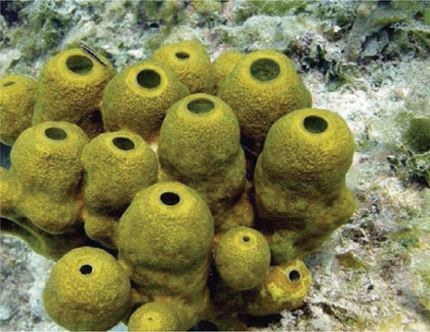
Osculum
Large opening – water goes out it

Slide 17
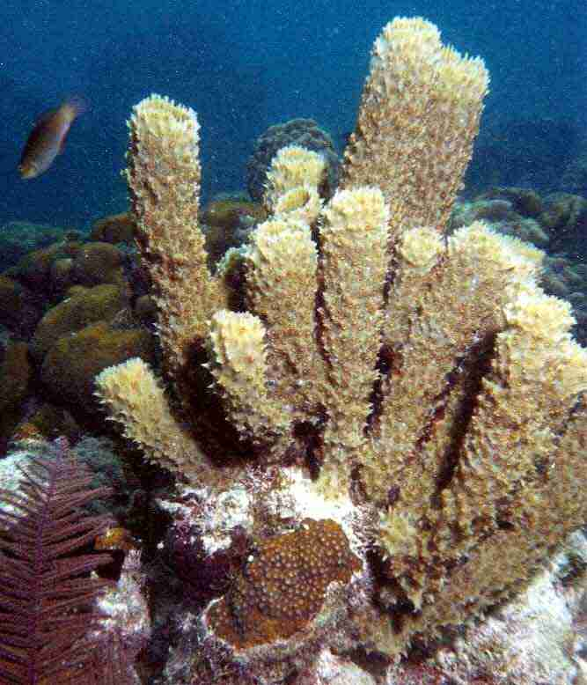
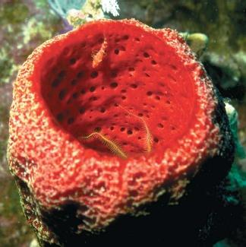
Phylum Porifera

Slide 18
Phylum Porifera
Sponges come in all shapes and sizes
The larger the sponge the more water the sponge can move through its body

Slide 19
Sponge Reproduction

Slide 20
Types of Sponge Reproduction
Sexual
What does this mean?
Asexual
What does this mean?

Slide 21
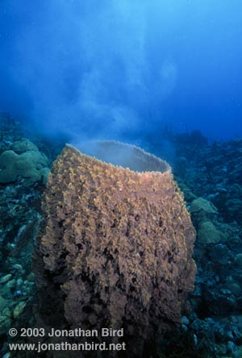
Sexual Reproduction
In most sponge spp (species) a single sponge forms both eggs and sperm.
They make the egg and sperm at different times
Why would it be a good thing to make them at different times?

Slide 22
Sexual Reproduction
The eggs are fertilized inside the sponge which is known as internal fertilization

Slide 23
Sexual Reproduction
Sperm from another sponge are taken through the pores of a sponge and the archaeocytes carry the sperm to an egg.
What is the other name for an archaeocyte?

Slide 24
After fertilization the zygote develops into a larva.
Larva are motile and are carried by currents before they settle on the sea floor

Slide 25
Questions
What type of fertilization do sponges do?

Slide 26
Asexual Reproduction
Sponges can reproduce asexually 1 of 2 ways
By budding or by producing gemmules
Asexual reproduction always makes a clone or an identical copy of the parent

Slide 27
Asexual Reproduction
Gemmules – groups of archaeocytes surrounded by a tough layer of spicules.
When conditions are favorable the gemmule grows into a new sponge

Slide 28
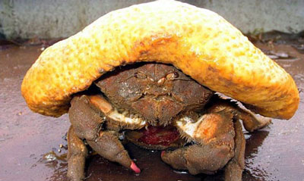
Ecological Roles - Competition
Need somewhere to attach
Compete with coral and bryozoans
Some crabs decorate themselves with sponges

Slide 29
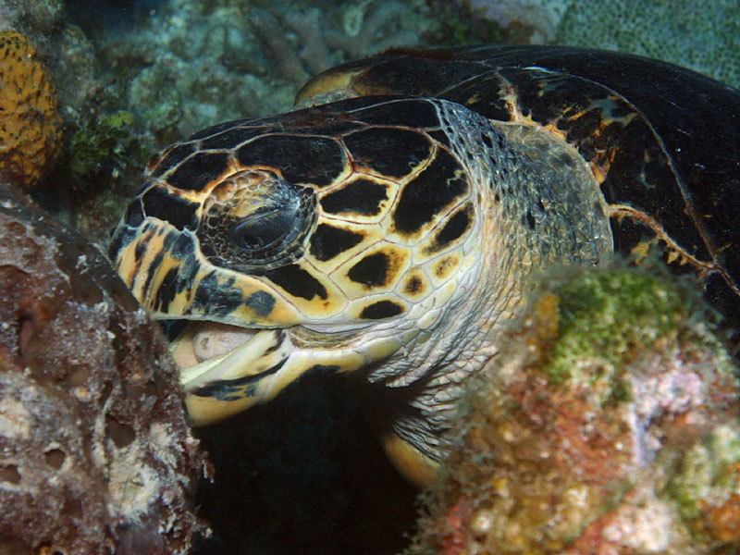
Ecological Roles – Predator/Prey
The spicules make it hard to eat but some fishes and sea turtles can eat them

Slide 30
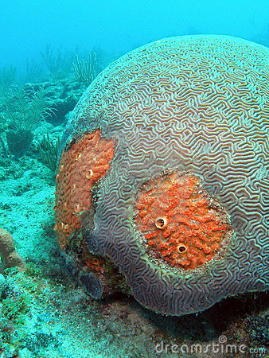
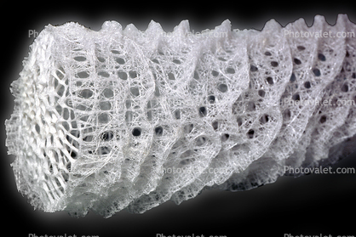
Ecological Roles - Symbiosis

