Slide 1
Phylum Echinodermata

Slide 2
What does echinodermata mean?
Spiny skin

Slide 3
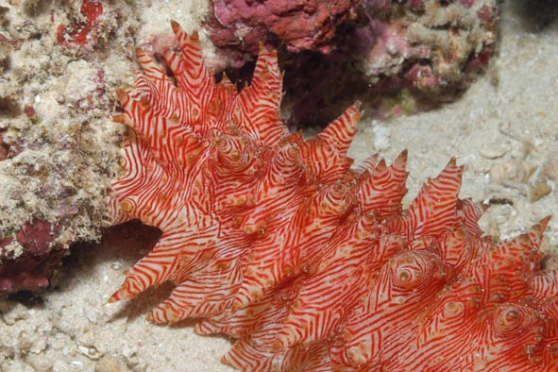
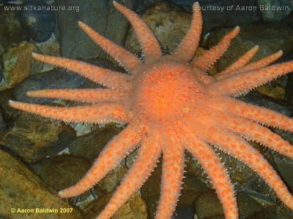
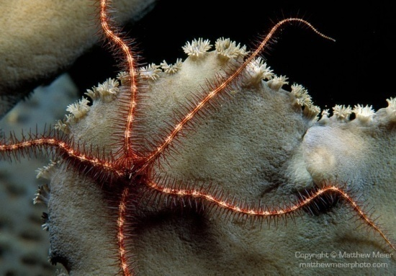
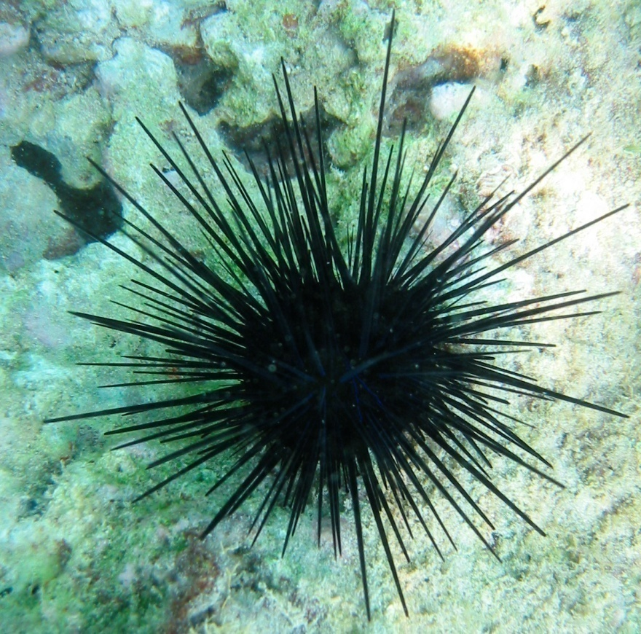
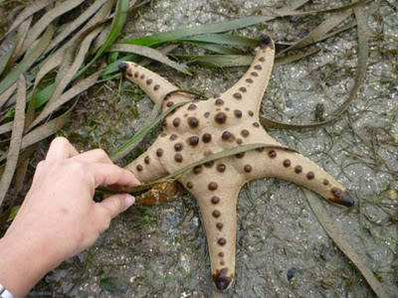
Examples of echinoderms

Slide 4
What is an echinoderm?
Typically have no anterior/posterior end
Lack cephalization
Invertebrates

Slide 5
Questions
What is an invertebrate?
What other phyla are invertebrates?

Slide 6
Characteristics of echinoderms
Spiny skin
5-part radial symmetry
Endoskeleton
Water vascular system
Tube feet

Slide 7
Radial symmetry
Body parts usually in multiples of 5
Pentamerism
Arranged around the central body like the spokes of a wheel.
Their larvae has bilateral symmetry

Slide 8
Echinoderm body
2 sided
Oral surface (mouth side)
Aboral surface (opposite mouth)

Slide 9
Echinoderm body
Endoskeleton
Made of hardened plates of calcium carbonate

Slide 10
Questions
What are the 2 sides to an echinoderm’s body?
Body parts are typically in multiples of what?
What is their endoskeleton made of?
What type of symmetry do they have?

Slide 11
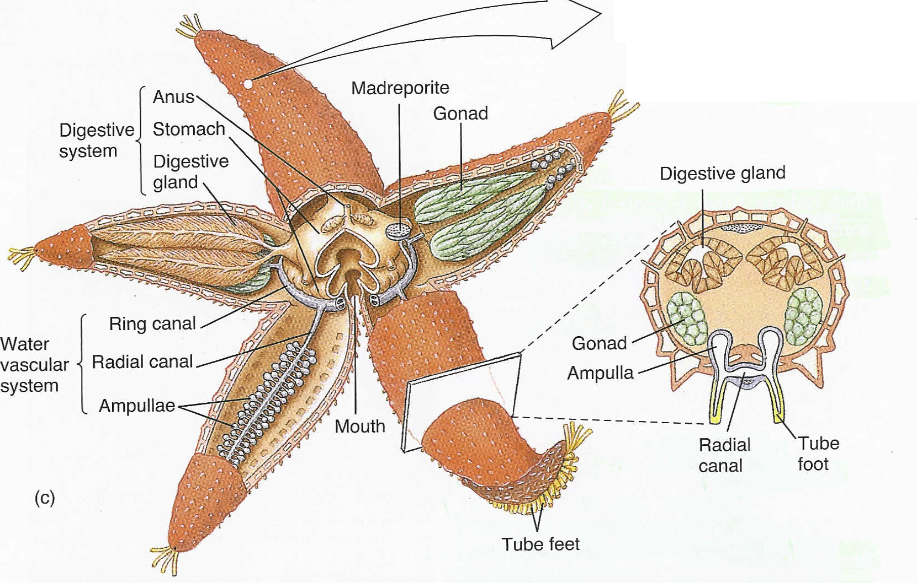

Slide 12
Water vascular system
System of internal tubes
Filled with fluid
Carries out essential body functions
Respiration
Circulation
Movement

Slide 13
Water vascular system
Madreporite
Ring canal
Radial canal
Ampullae

Slide 14
Question
What is the system of internal tubes in echinoderms?
What are some of the parts to this system?

Slide 15
Digestive system
Digestive gland
Stomach
Anus (on aboral side)

Slide 16
Oral side anatomy
Mouth
Ambulacral groove (groove where tube feet are)

Slide 17
movement
Tube feet
Operates like a suction cup
There is a muscle that pulls the center of the sucker upwards (making a cup shape)
This makes suction on the surface

Slide 18
eyespots
Echinoderms don’t have eyes
What is the function of eyespots?

Slide 19
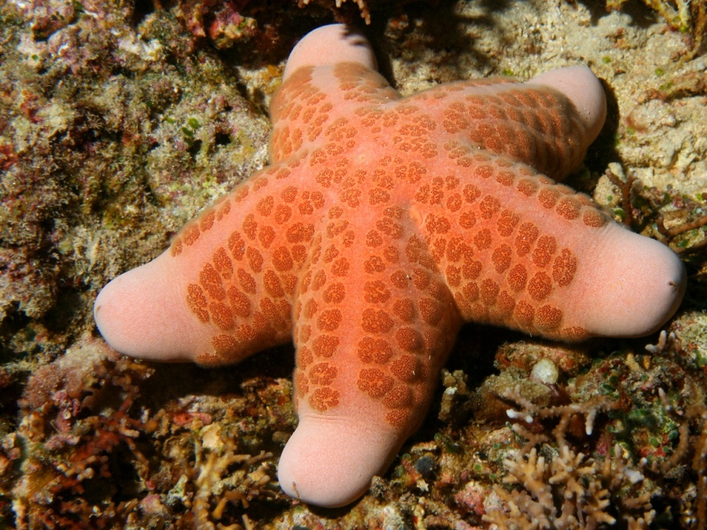
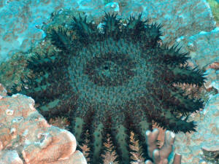
Class asteroidea
Sea stars
Most are carnivorous
Many have the ability to repair themselves if damaged.
If it is pulled into pieces, each piece will grow into a new animal – as long as it contains a portion of the central part of the body

Slide 20
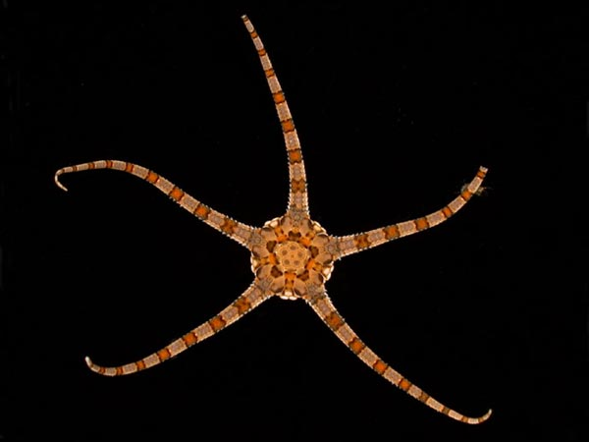
Class Ophiuroidea
Brittle Stars
Filter Feeders
Lose their arms if attacked to deter predators

Slide 21
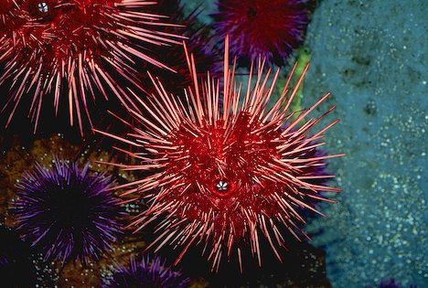
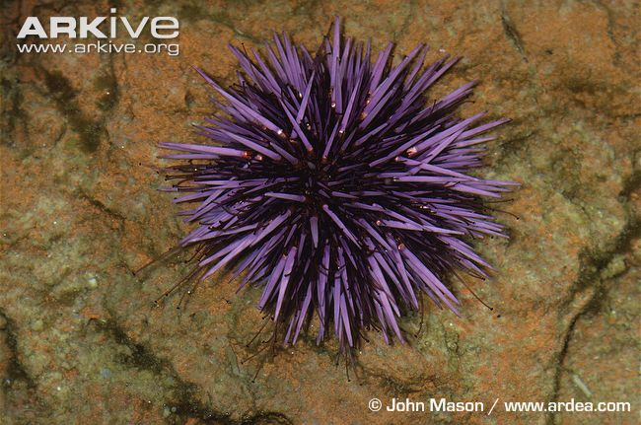
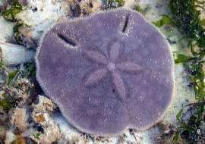
Class echinoidea
Sea urchins and sand dollars
Have large solid plates that form a box around their internal organs

Slide 22
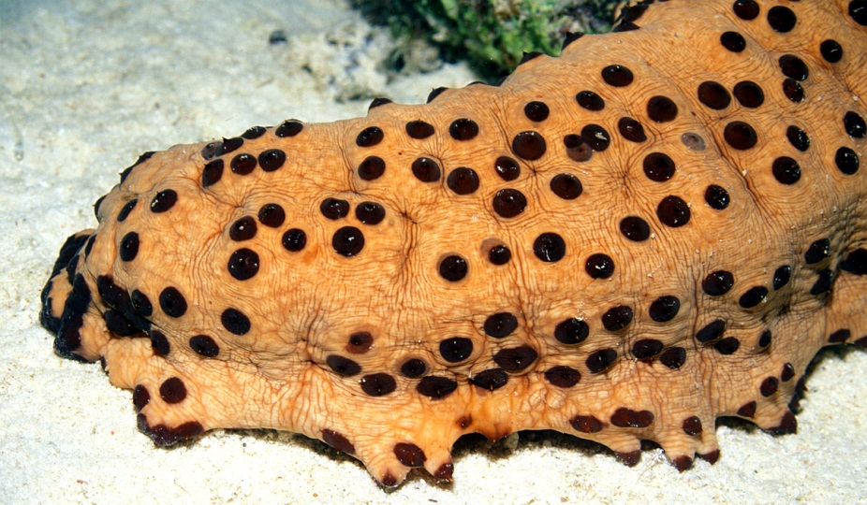
Class Holothuroidea
Sea Cucumbers
Vacuum of the sea
Form herds
Eat organic matter from the ocean floor

