Slide 1
Phylum Cnidaria

Slide 2
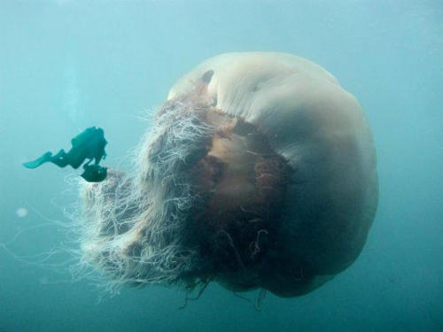
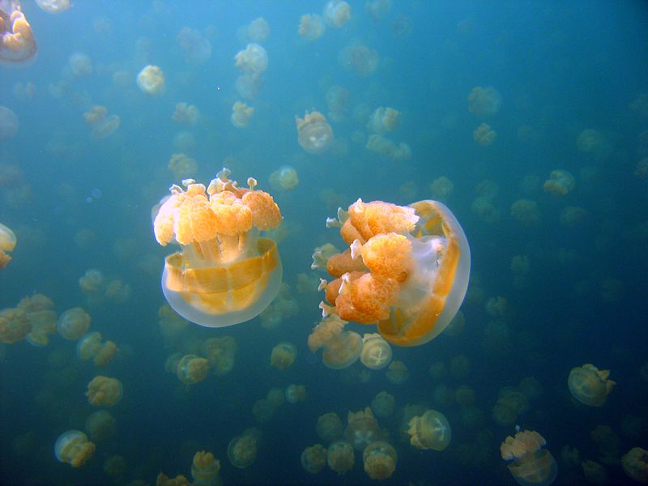
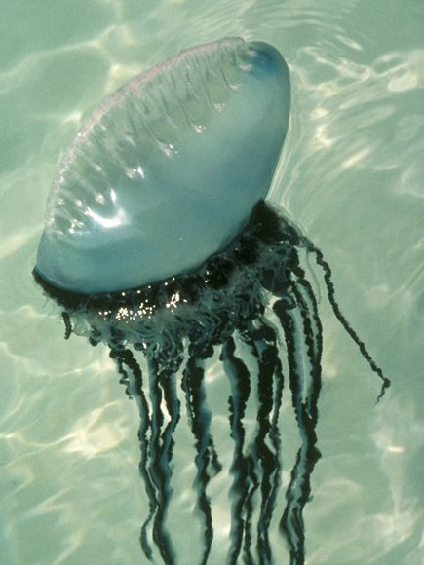
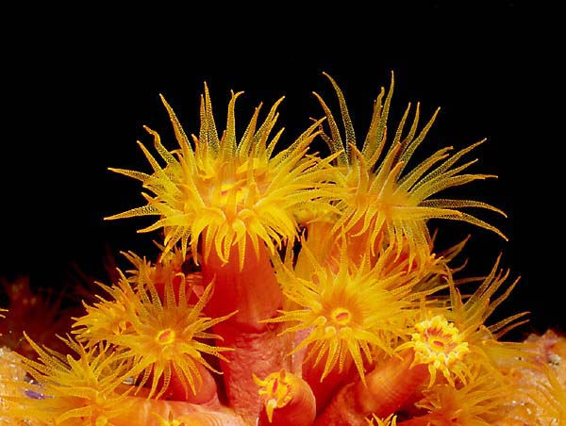

Slide 3
What are Cnidarians?
http://www.youtube.com/watch?v=wOXO4F9dzd8

Slide 4
Groups of Cnidarians
Jellyfishes (class Scyphozoa – cup animals)
Hydras (class Hydrozoa)*
Sea anemones (class Anthozoa – flower animal)*
Corals (class Anthozoa – flower animal)*
*only have polyp stage of life cycle

Slide 5
Questions
What domain are we focusing on in this class?
What kingdom are we focusing on?
What is the phylum for jellies, coral, hydras, sea anemones?

Slide 6
Characteristics of Cnidarians
Soft-bodied
Carnivorous
Have stinging tentacles arranged in a circle around their mouth
Most simple animals with body symmetry & specialized tissues

Slide 7
Question
Why is it important that their tentacles are arranged around their mouth?

Slide 8
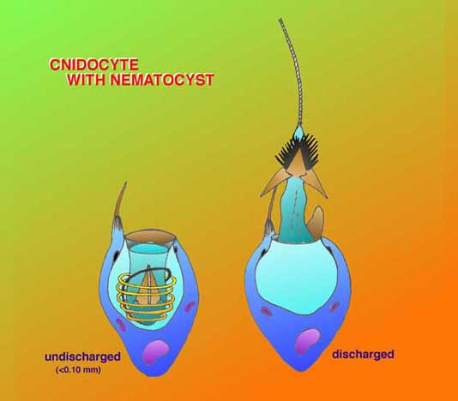
Where does the name Cnidaria come from?
From their stinging cells – cnidocytes
These cells are used for defense and to capture prey

Slide 9
Nematocyst
Located within a cnidocyte
This is the poison filled stinging structure – has a tightly coiled dart

Slide 10
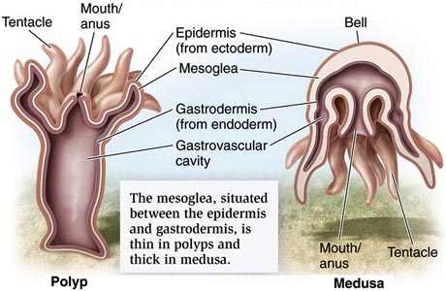
Body Plan
Few cells thick and have a simple body system
Have a central mouth surrounded by numerous tentacles that extend outward from the body.
2 tissue layers
Epidermis (outer)
Mesoglea (middle goo)
Gastroderm (inner)

Slide 11
Questions
What are the stinging cells called?
What is the name of the actual poisonous dart in the stinging cells?
Why is it advantageous to be only a few cells thick when you are a marine organism?

Slide 12
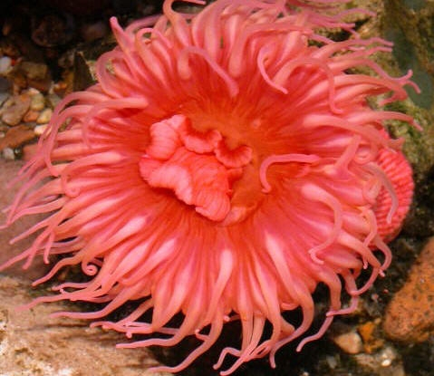
Symmetry
Cnidarians are radially symmetrical
Like spokes on a wheel no matter how you divide it through the middle it is symmetrical

Slide 13
Questions
What type of symmetry do poriferans have?
What type of symmetry do cnidarians have?

Slide 14
Life Cycle
Typically have a life cycle that includes two different-looking stages.
Polyp
Medusa

Slide 15
Polyp
Cylindrical body with armlike tentacles
The mouth points upward – why is this important?
Usually sessile

Slide 16
Medusa
Motile
Bell shaped
Mouth on bottom – why would their mouth be on the bottom?

Slide 17
Cnidarian Reproduction
Sexual
Typically in the medusa stage
Typically have a planula larvae
Asexual
Typically in the polyp stage

Slide 18
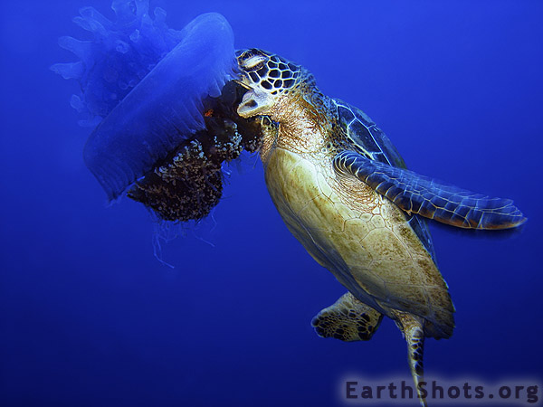
Ecological Roles – Predator-Prey
Cnidarians are predators
Sea turtles, some fish and mollusks will feed on jellies

Slide 19
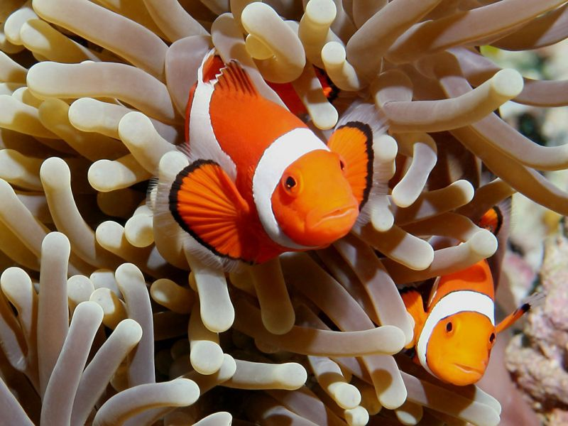
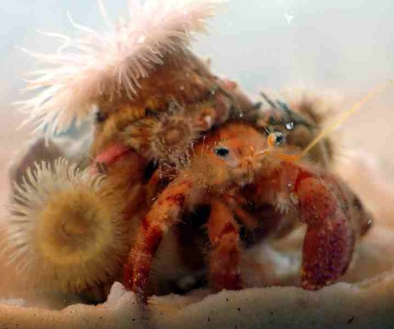
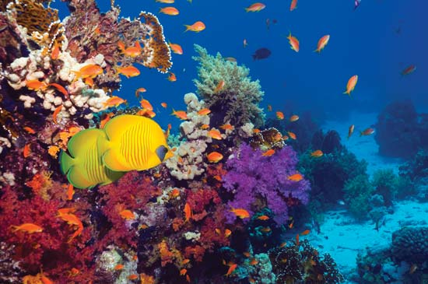
Ecological Relationships - Symbiosis
Mutualism
Clownfish and anemone
Hermit crab
Coral and zooxanthellae

Slide 20
Phylum Ctenophora

Slide 21
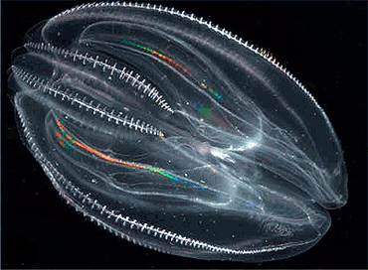
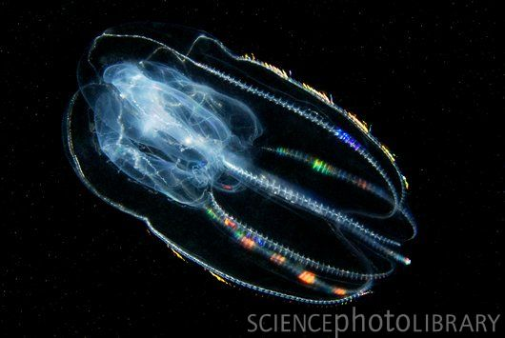
http://www.youtube.com/watch?v=5MKq6CvxR7w

Slide 22
Differences/Similarities Between Cnidarians and Ctenophores
Ctenophores
Cnidarians
Gelatinous
Transparent bodies
*Lack stinging cells
Planktonic
Found mostly in surface waters
Luminescent/Iridescent
Have 8 rows of comb plates
Used for locomotion

