Slide 1
Phylum Arthropoda

Slide 2
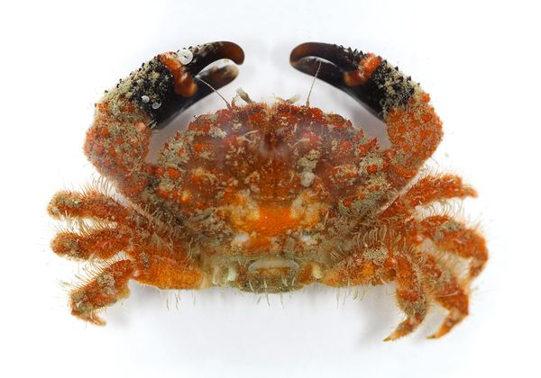
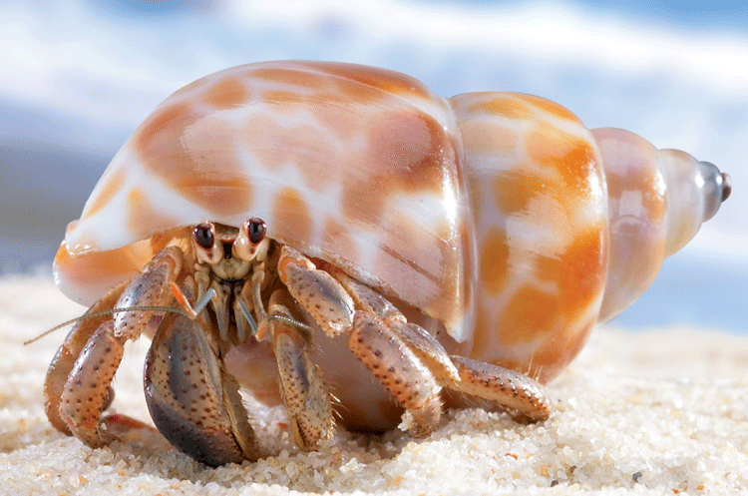
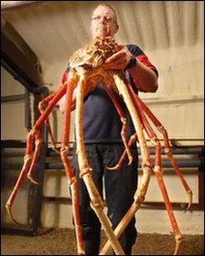
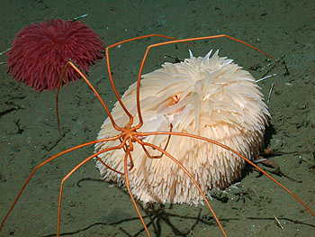
What are arthropods?
Insects
Crabs
Spiders

Slide 3
Why are they grouped even though they are so different?
All have segmented bodies
Tough exoskeleton
Jointed appendages

Slide 4
Question
What does “exo” mean – hint it means the same thing as “ecto”

Slide 5
Exoskeleton
Tough outside covering
armor
Made from protein and a carbohydrate
CHITIN

Slide 6
Question
How do arthropods grow if they have tough exoskeletons, that don’t grow?

Slide 7
Answer
Arthropods molt – means they shed their exoskeleton and grow a new one
http://www.youtube.com/watch?v=DdpNBOiRbgg

Slide 8
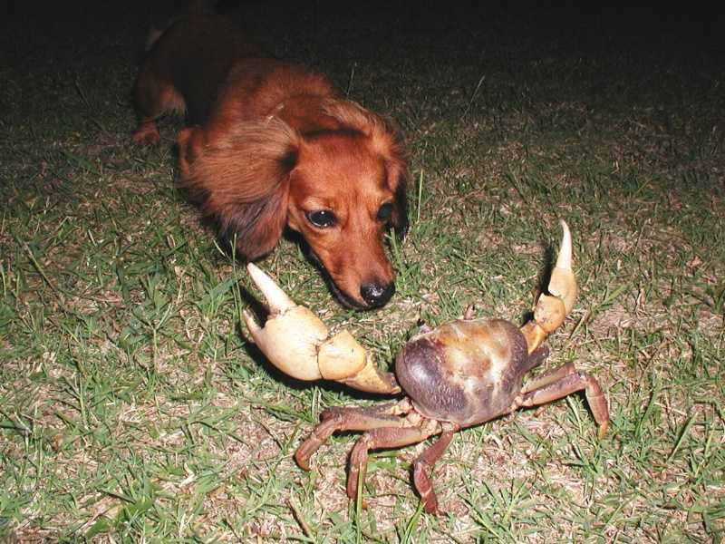
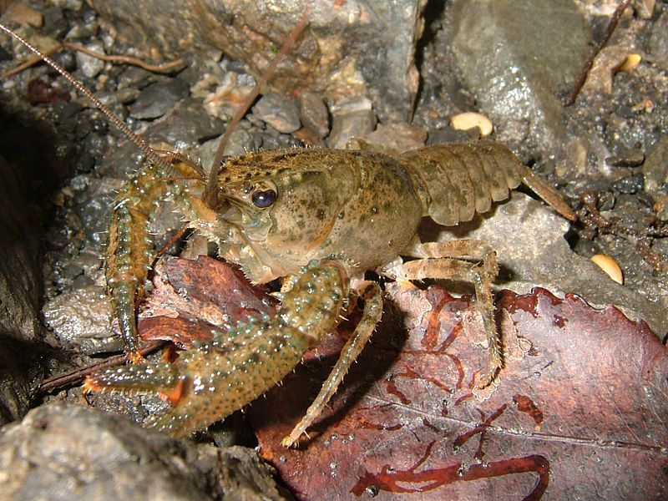
Variations in Exoskeletons

Slide 9
Question
What is an appendage?

Slide 10
Appendages
Arthropods have jointed appendages
This is why they got their name – means “jointed foot”

Slide 11
Groups of Arthropods
Mandibulates
Chelicerates
Insects

Slide 12
Mandibulates
Typically in subphylum Crustacea
Primarily aquatic
Typically have 2 pairs of branched antennae
2 or 3 body sections
Mandibles (chewing mouthparts)

Slide 13
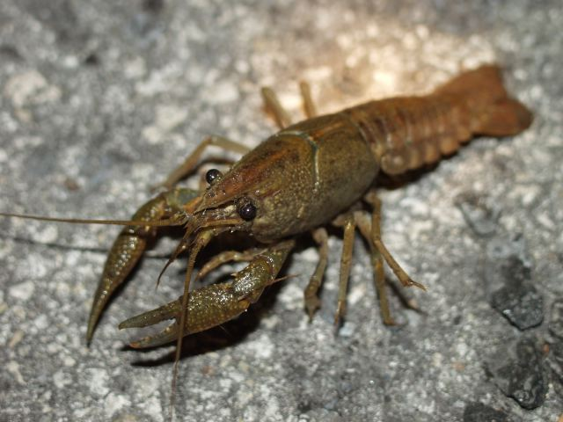
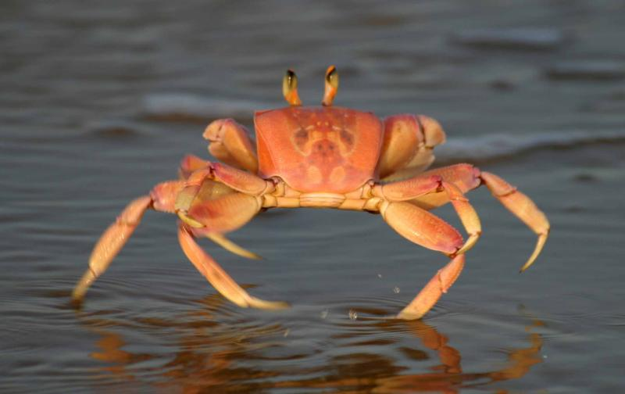
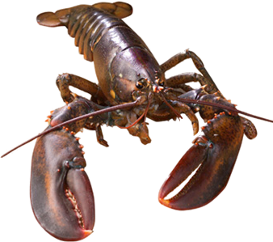
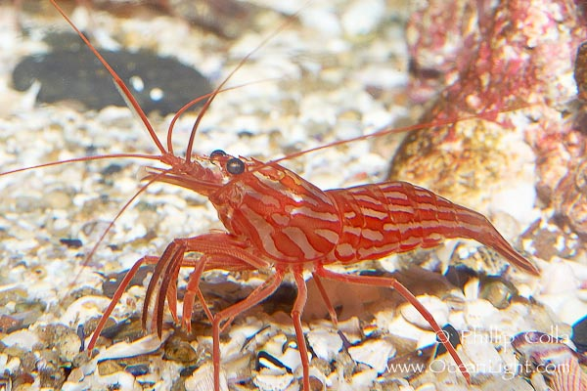
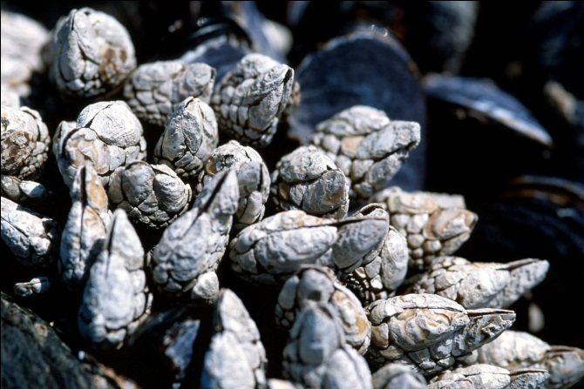
Mandibulates Pictures

Slide 14
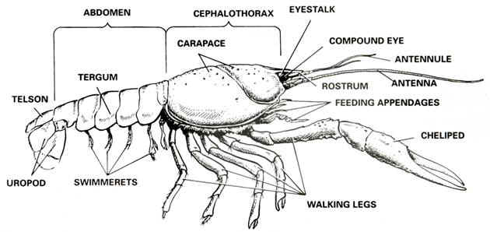
Typical Crustacean

Slide 15
Question
Where have you seen the prefix “cepha” before

Slide 16
Cephalothorax
Formed by fusion of the head and thorax (right after head)
Most of the internal organs are inside

Slide 17
Abdomen
Posterior part of the body

Slide 18
Carapace
Part of exoskeleton that covers the cephalothorax

Slide 19
Appendages
Projecting part of an organism – can you give me examples?

Slide 20
Appendages in Mandibulates
Pair 1 & 2 – antennae
3rd pair – mandible – what are these?

Slide 21
Appendages in Mandibulates
Crayfishes, Lobsters, & Crabs are members of the largest group of crustaceans – order Decapoda

Slide 22
Question
What does “deca” mean?

Slide 23
Order Decapoda
Have 5 pairs of legs = 10 legs total
1st pair called chelipeds adapted into large claws
Other 4 pairs – walking legs
Swimmerets – along abdomen flipperlike appendages used for ….

Slide 24
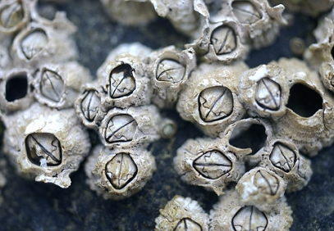
Barnacles - Mandibulates
Sessile – what does that mean?
Lost their abdominal segments & no longer use mandibles
Used to be classified as mollusks because of shell like covering
Are ectoparasites – what does that mean?

Slide 25
Questions
What are the body segments of a crustacean?
What are the first 2 pairs of appendages used for?
What are swimmerets used for?
What does decapod mean?

Slide 26
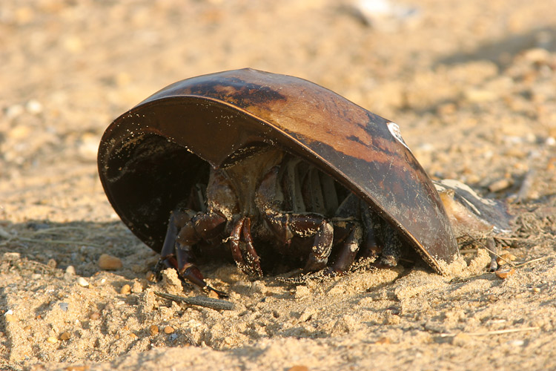
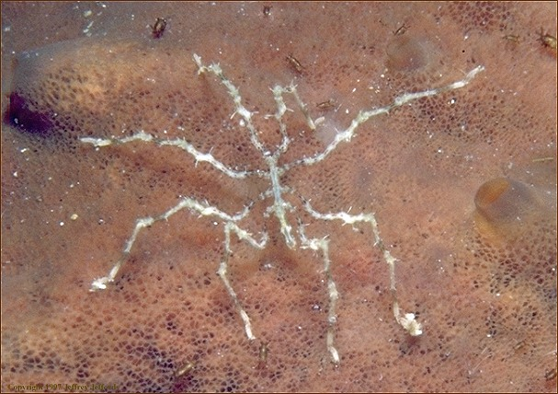
Chelicerata (sub phylum)
Horseshoe crabs
Sea spiders

Slide 27
Chelicerate Body Plan
Mouthparts called chelicerae
2 body sections (same as crustacean which are?)
Nearly all have 4 pairs of walking legs
Have 2 pairs of appendages attached near the mouth (adapted as mouthparts)
1 pair chelicerae (fangs)
Other pair pedipalps (grab prey)

Slide 28
Question
What does “pedi” mean?

Slide 29
Chelicerate Groups
Horseshoe Crabs
Sea Spiders

Slide 30
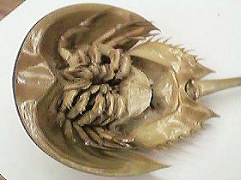
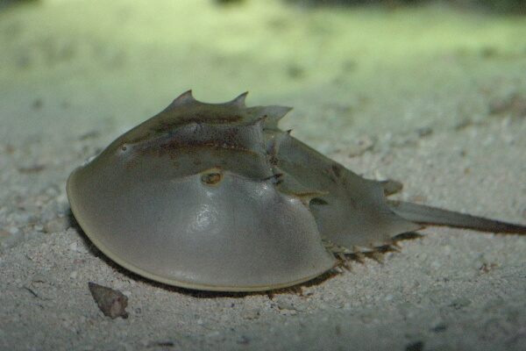
Horseshoe Crabs Class Meristomata
Called a “living fossil” because they have remained unchanged for 500 million years
Not true crabs – anatomy closer to a spider
Have chelicerae, 5 pairs of walking legs, and a long spikelike tail - telson

Slide 31
Class Pycnogonida
Found all over in oceans but especially in polar seas
Typically have 4 pairs of walking legs (some may have more)
Some males have an extra pair of appendages to carry eggs – only known marine invert. That males carry the eggs.
Feed on cnidarians and other soft invertebrates – they extract juices with a long sucking proboscis

Slide 32
Questions
What are the two groups of chelicerates?
What is a cephalothorax?
How many body segments do chelicerates have?

