Slide 1
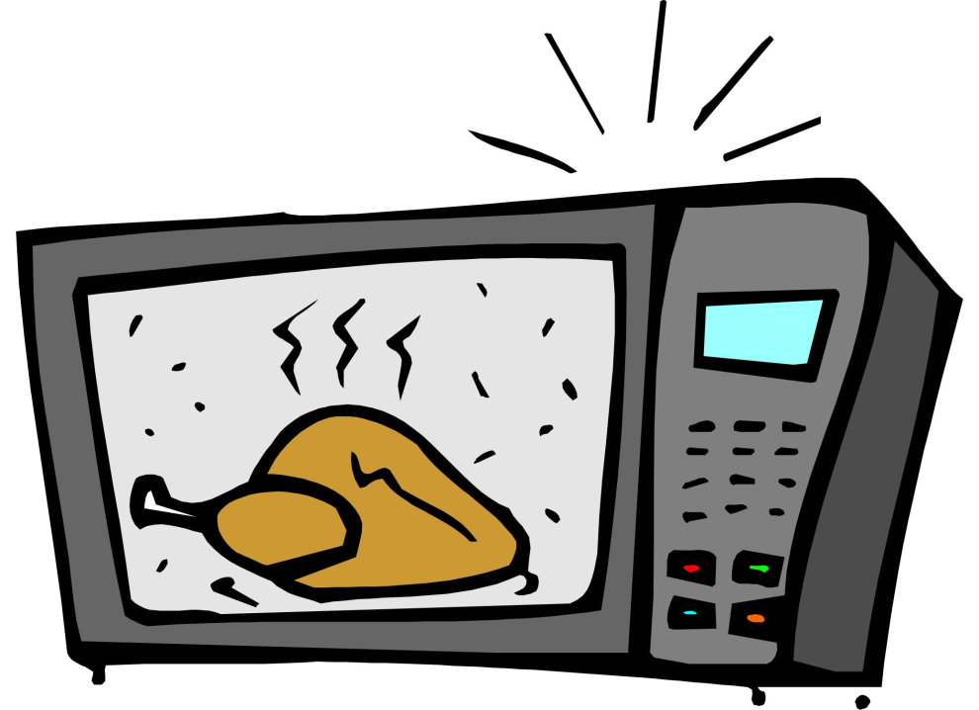
Microwave Cooking

Slide 2
How long have microwaves been around?
In 1945, Dr. Perry Spencer, a scientist, was working in a lab when he felt some heat on his hand. The heat was coming from microwaves. These were being emitted from a nearby vacuum tube. Dr. Spencer was curious and place a chocolate bar near the tube. Within seconds, the chocolate melted. That sticky mess was the beginning of a brilliant idea – the microwave!

Slide 3
Diagram of Microwave

Slide 4
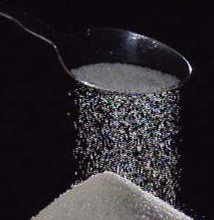
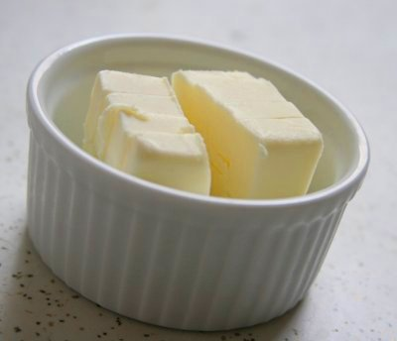
1. Microwaves are ATTRACTED to:
Sugar
b. Fat
c. Water

Slide 5
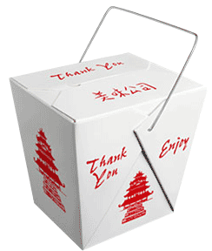
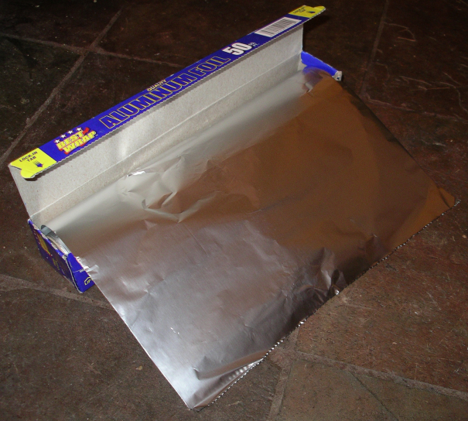
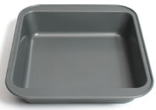
2. Microwaves are REPELLED by:
Metal
Like What?

Slide 6
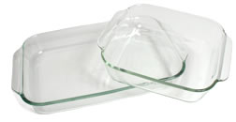
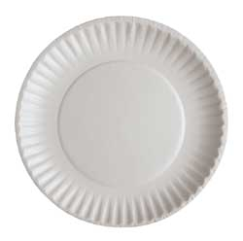
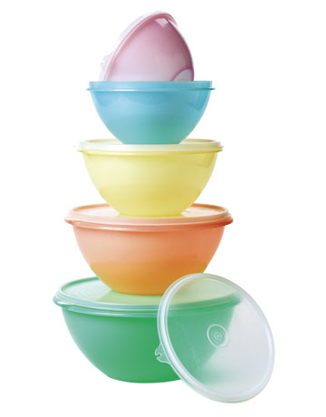
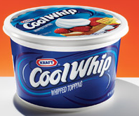
3. What materials or containers are microwave safe?
Glass
Paper
Plastic
(Heat Tempered!)

Slide 7
4. What part of the microwave oven generates the microwaves?
The Magnetron!

Slide 8
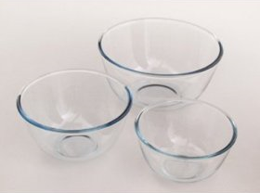
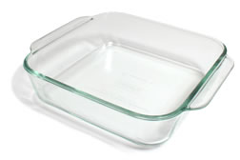
5. Which container cooks more evenly…
ROUND
or
SQUARE
Why?!?
Because it allows the microwaves to enter the food from as many sides as possible. They won’t “bounce off” the corners.

Slide 9
How Does a Microwave Work?
The microwave oven generates electromagnetic waves (called microwaves) which makes water move. This motion leads to friction, and friction leads to heating.
Motion Friction Heat

Slide 10
How Does a Microwave Work?
This heat starts on the outside of the food and moves in.
The denser the food the longer it will take to cook.
Water will heat faster than a burrito, because a burrito is more dense than water.

Slide 11
6. WHAT is standing time and WHY is it important?
WHAT: The amount of time food is allowed to sit AFTER microwave cooking in order to finish the cooking process.
WHY: If you don’t allow for standing time, you will overcook your food.

Slide 12
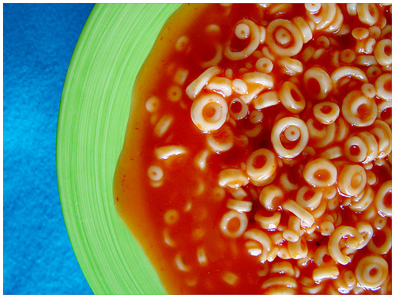
7. Why should you stir or rotate food when microwave cooking?
It helps the food cook more evenly by redistributing the heat.
(Foods cooked in the microwave will cook from the edges in.)

Slide 13
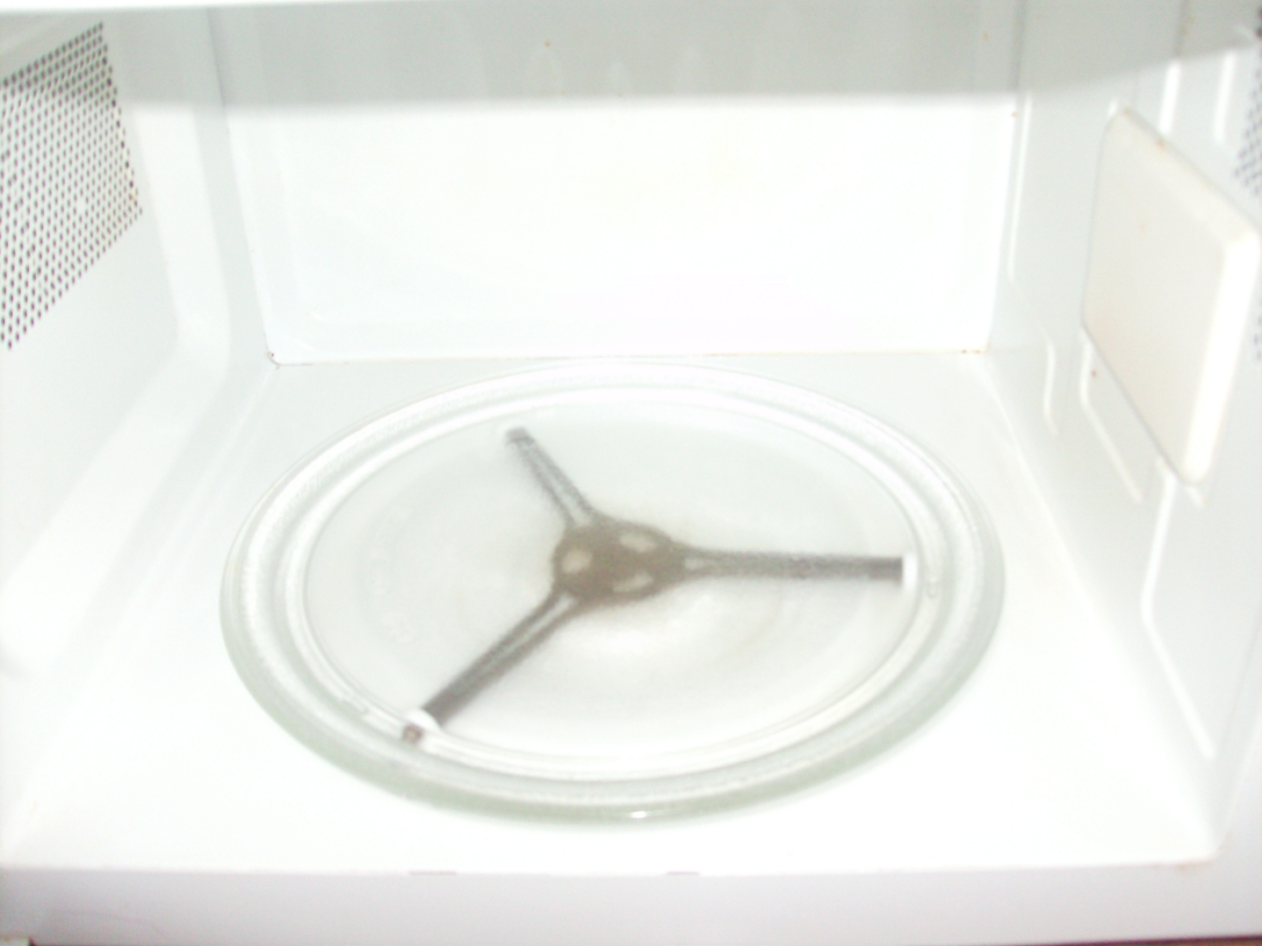
8. What part of the microwave will rotate the food WHILE it is cooking?
A Turntable

Slide 14
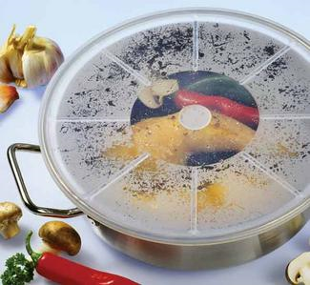
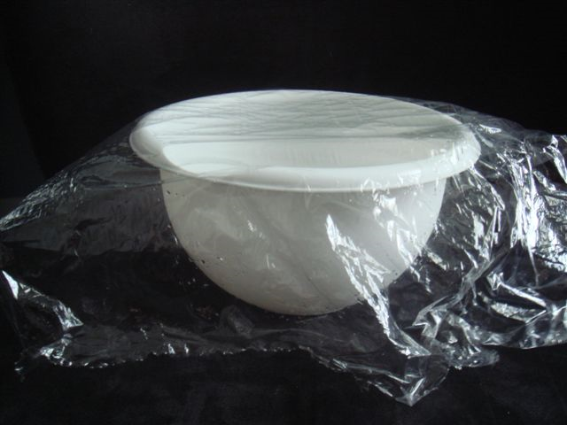
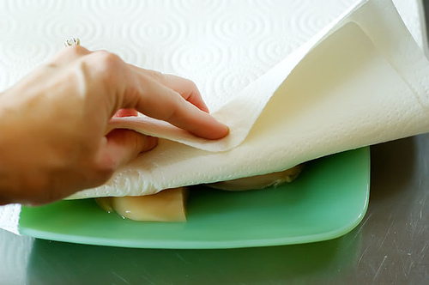
9. Why is it best to cover most foods when microwave cooking?
It holds in steam to shorten cooking time
Keeps food moist
Keeps foods from splattering

Slide 15
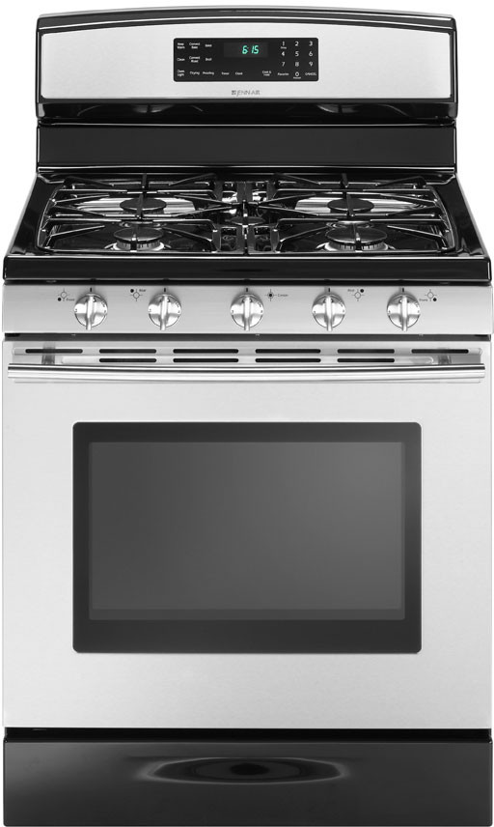
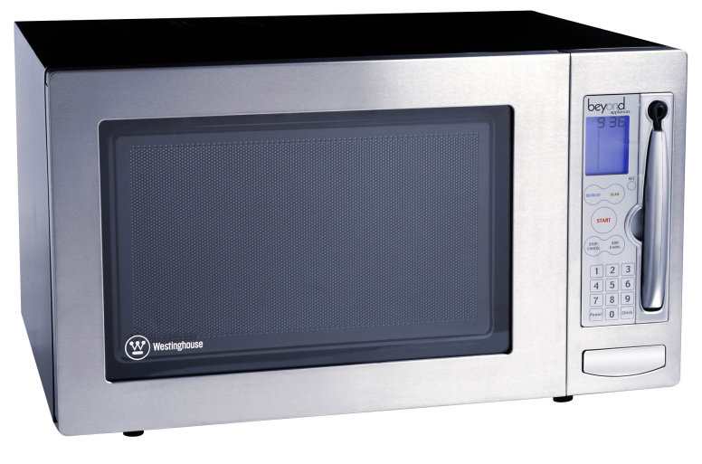
10. Why do foods NOT brown in the microwave?
Because there is no dry heat to pull the moisture away from the food.
VS.

Slide 16
11. How can you prevent burns when microwave cooking?
Use hot pads or oven mitts
Lift steamy lids away from you
Use only microwave safe dishes

