Slide 1
Marine Mammals
Class Mammalia

Slide 2
Mammalian Characteristics
Have hair
Endothermic
Mammary glands
Placental – keep babies inside until ready to be born

Slide 3
Groups of Mammals
Pinnipeds
Sirens
Cetaceans

Slide 4
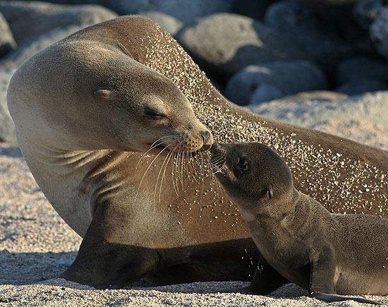
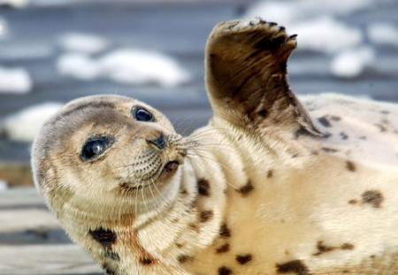
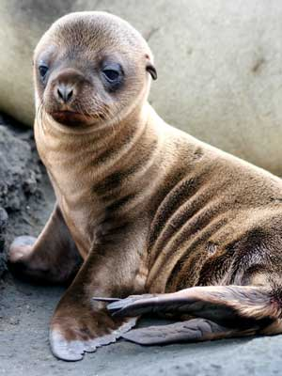
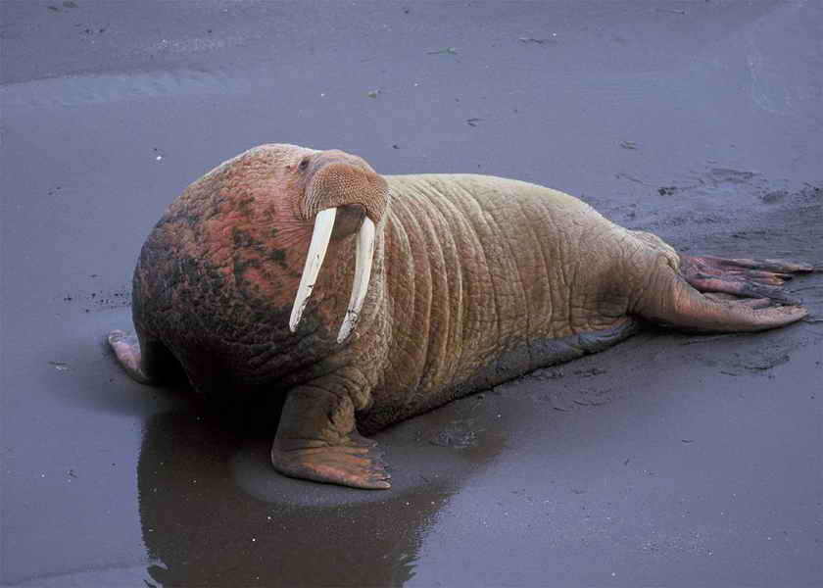
Suborder Pinnipedia – Order Carnivora

Slide 5
Pinnipeds
All give birth on land
Retain the 4 limbs that are characteristic of terrestrial mammals.
Found all over the world but prefer colder waters
Fast swimmers
Most exhale their air before they dive
Can store 10-30 times more oxygen in their muscles than other mammals

Slide 6
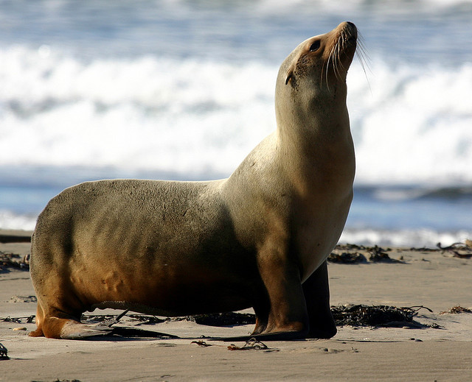
Eared Pinnipeds – Sea Lions
Have visible external ears
Limbs can support them on land
Main propulsion in water comes from forelimbs – hind limbs are used for steering

Slide 7
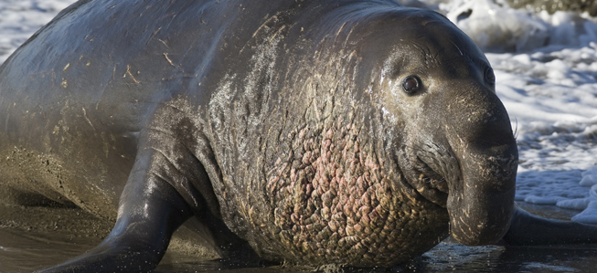
True Seals
Lack external ears – more streamlined for water
Limbs can’t support weight on land
Use hind limbs for propulsion in the water

Slide 8
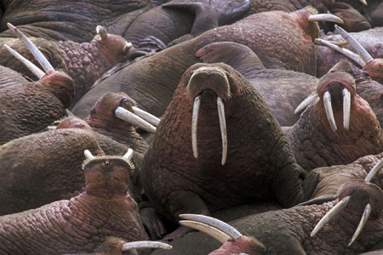
Walruses
Lack external ears
Canine teeth are modified into tusks used for fighting other males – also used to help get onto the ice!
Males are known to kill their young – females care for the young

Slide 9
Depths and Durations of Pinniped Dives
Species | Maximum Depth (meters) | Maximum Duration of Breath-hold (minutes)
Northern elephant seal (male) | 1530 | 77
Southern elephant seal (female | 1430 | 120
Weddell seal | 626 | 82
Crabeater seal | 528 | 10.8
Harbor seal | 508 | 7
Harp seal | 370 | 16
California sea lion | 482 | 15
Steller sea lion | 424 | 6
Northern fur seal | 207 | 8
Antarctic fur seal | 181 | 10
Guadalupe fur seal | 82 | 18
Walrus | 300 | 12

Slide 10
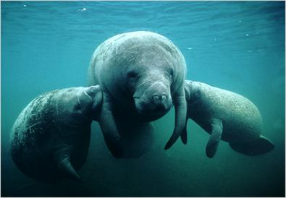
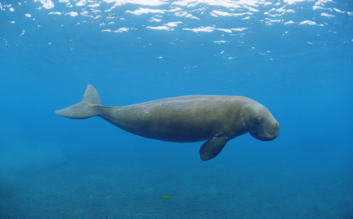
Order Sirenia

Slide 11
Sirenians
Completely aquatic
Confined to coastal areas and estuaries
Streamlined, practically hairless bodies
Forelimbs that form flippers, a vestigial pelvis and no hind limbs

Slide 12
Manatees
3 species
Vegetarians
Endangered because of overhunting and they move slow so they get cut by boats
Found in the Americas & Africa

Slide 13
Dugongs
Single species
Herbivore
Notched tail
Found in coastal estuaries of India and Asia

Slide 14
Sad Sirenian Story
Steller’s Sea Cow
Was found in the Arctic waters
“tasty meat”
Steller found it in 1742 – it was hunted to extinction in 27 years

Slide 15
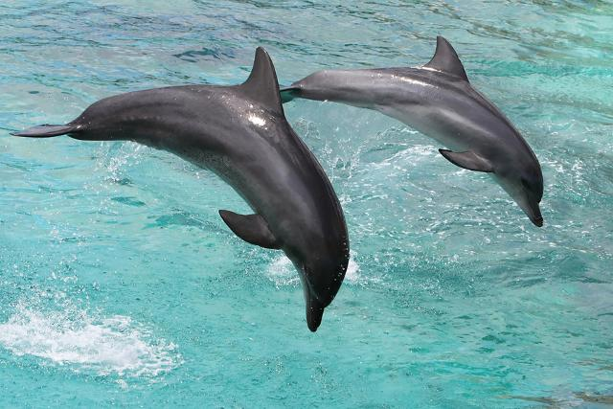
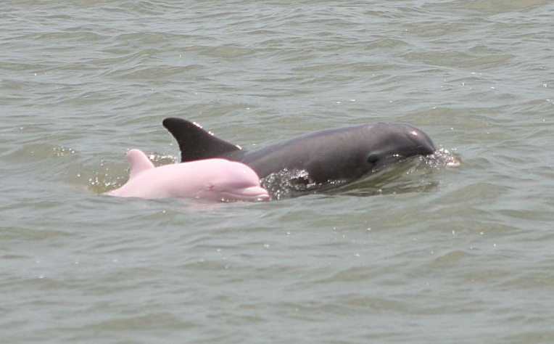
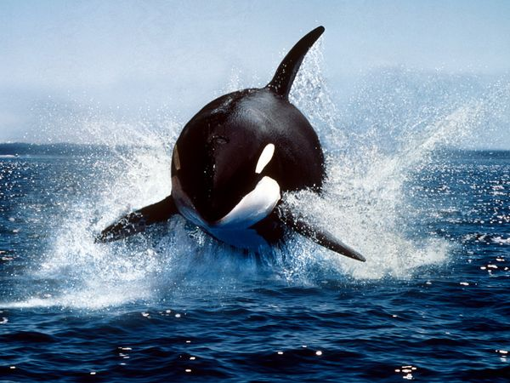
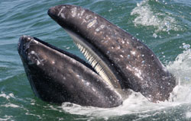
Order Cetacea

Slide 16
Order Cetacea
Most extensively adapted to a marine environment
Body closely resembles fishes
Whale fetuses resemble terrestrial mammals
Rear appendages disappear externally before birth
Nostrils are at end of snout pre-birth and migrate to form blowhole!!!!!
http://www.youtube.com/watch?v=8cn0kf8mhS4

Slide 17
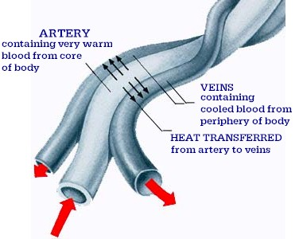
Cetaceans
Don’t really have much hair – except on heads
Skin lacks sweat glands – reduces loss of water in marine environment

Slide 18
Adaptations for Diving
They can exchange nearly all the oxygen in their lungs with their blood (80-90%) Humans only exchange 15-25%
Metabolism decreases heart beats at 10% of normal
Twice as much blood per pound of body weight as humans

Slide 19
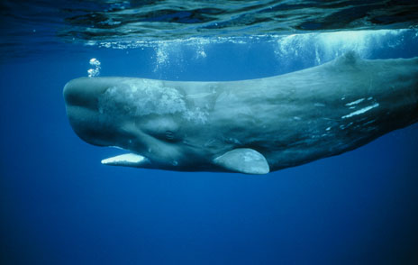
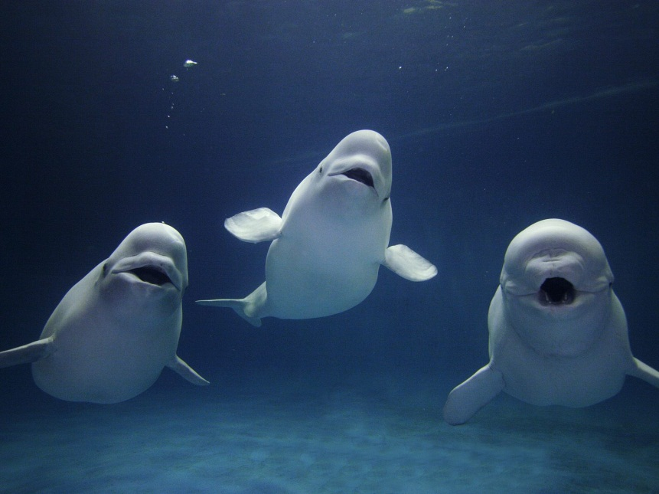
Different Whales
Baleen & Toothed Whales

Slide 20
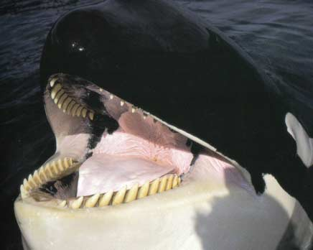
Different Whales
Baleen & Toothed Whales

Slide 21
Crazy Whale Facts
Gestation periods of different whales
Baleen whales – 10-13 months
Toothed whales – 7-17 months
Baby blue whales
Double birth weight in weight first week
Gain 200 pounds a day after that!!!!

Slide 22
Whales
http://www.youtube.com/watch?v=jJGeeryk0Eo
http://www.pbs.org/wgbh/americanexperience/features/bonus-video/whale-vocalizations/iu

Slide 23
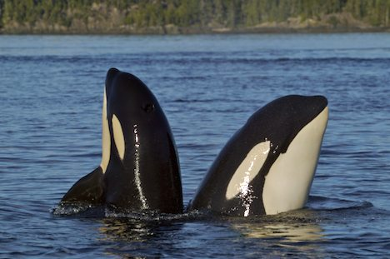
Cetacean Behaviors – Spy Hopping

Slide 24
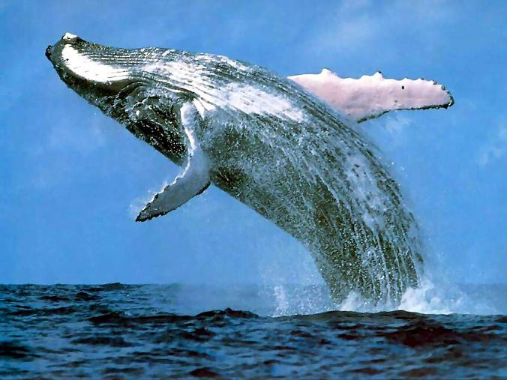
Cetacean Behaviors – Breaching

Slide 25
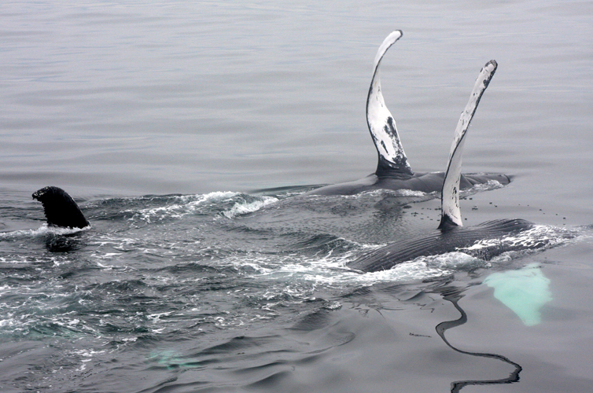
Cetacean Behaviors – Slapping

Slide 26
Dolphins are Toothed Whales!!!!
They are the most numerous cetaceans
Belong to family Delphinidae
Extremely intelligent
Playful/social
Appear to like the company of other species
Have many times saved drowning/injured humans

Slide 27
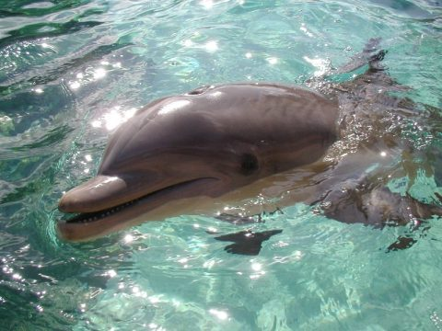
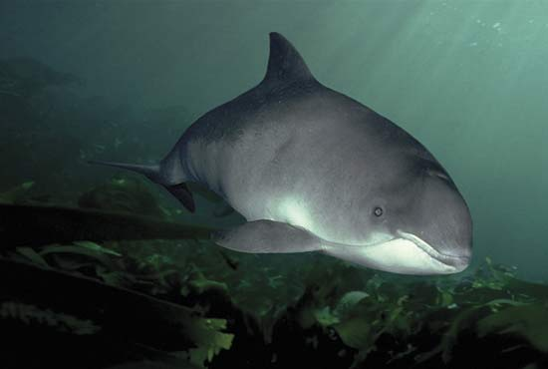
Dolphins vs. Porpoises
Dolphins
Porpoises
Have a beak
Means “pigfish”
No beak

Slide 28
Different Types of Dolphins
http://www.dolphinkind.com/TYspinner.html
The largest dolphin is the killer whale (orca)
Only whale known to eat endothermic prey (other mammals)

Slide 29
Dolphin Behaviors
Hunting behaviors
Clever
2 captive dolphins trying to eat a moray eel

Slide 30
Echolocation
Toothed whales can’t see more than 100 feet in front of them in clear water
They have very advanced ears to compensate
Orientation clicks – low frequency give idea of surroundings
Discrimination clicks – tell animal exactly what they are “looking” at

Slide 31
Dolphins Are Very Intelligent
http://www.youtube.com/watch?v=7hzUZE5bdfI
http://www.youtube.com/watch?v=ZoNDW0zSRNo
http://www.youtube.com/watch?v=bwhoLlu8D_g

