Slide 1
Fishes

Slide 2
What is a fish?
Aquatic vertebrates that have paired fins, scales, and gills.
Of course there are exceptions ☺
There are approx. 24,000 living species

Slide 3
Questions
What is the function of fins?
What is the function of scales?
What is the function of gills?

Slide 4
Groups of Fishes
Jawless Fishes
Cartilaginous Fishes
Bony Fishes

Slide 5
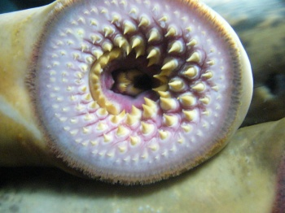
Jawless Fishes
Superclass Agnantha
Includes: lamprey & hagfish
http://www.britannica.com/EBchecked/topic/9280/agnathan

Slide 6
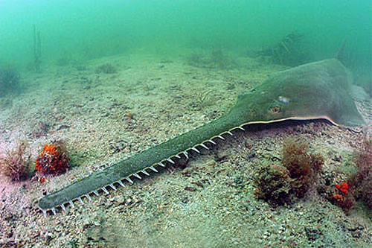
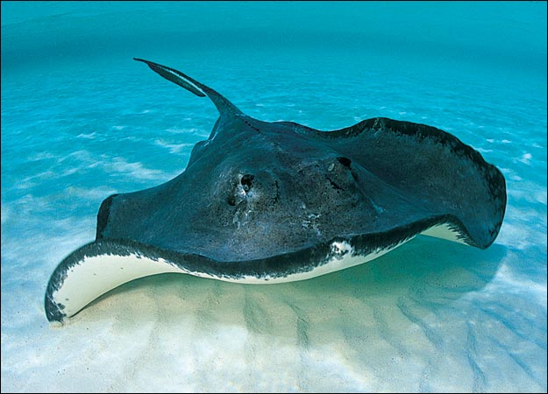
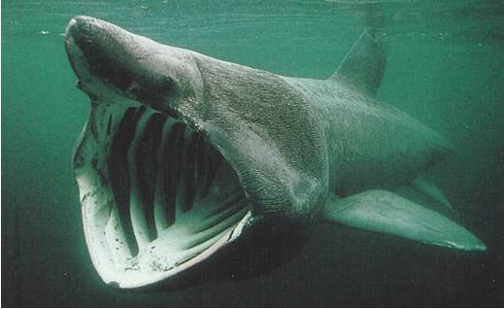
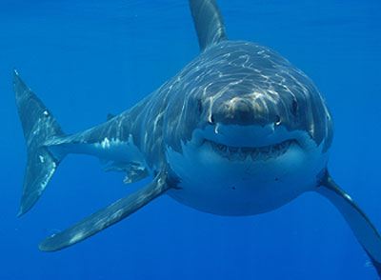
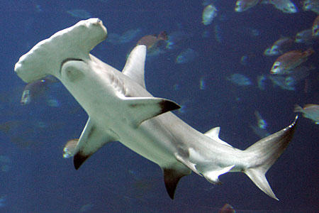
Cartilaginous Fishes
Class Chondrichthyes
Includes: sharks, rays, skates, sawfishes and chimaeras

Slide 7
Bony Fishes
Class Osteichthyes
Skeletons of these fishes are made of a hard calcified tissue – called bone
2 groups within bony fishes
Ray-finned fishes
Lobe-finned fishes

Slide 8
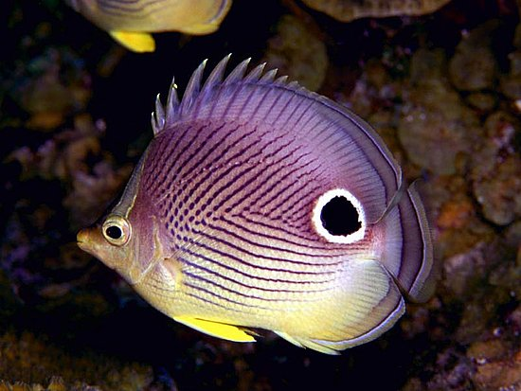
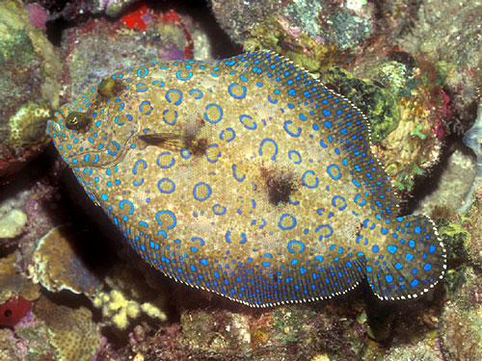
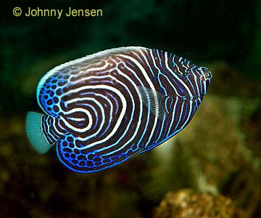
Ray Finned Fishes
Most bony fishes are ray-finned
Refers to the slender bony spines or rays that form the fins (like a fan)

Slide 9
Bony Fishes

Slide 10
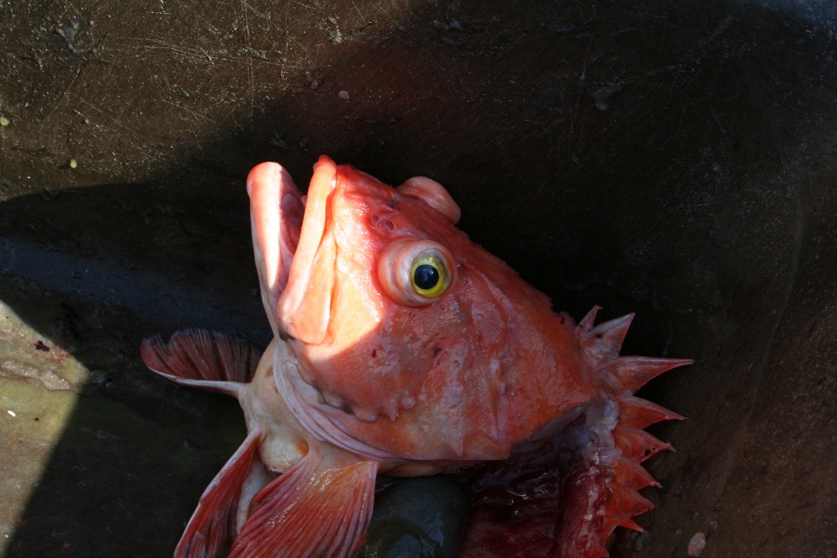

Slide 11
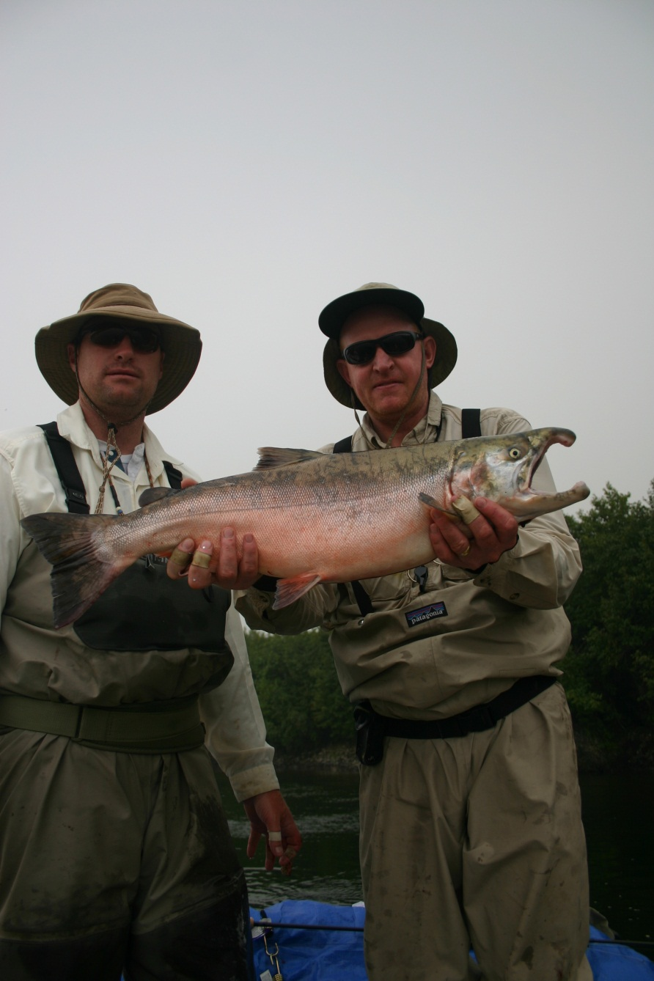
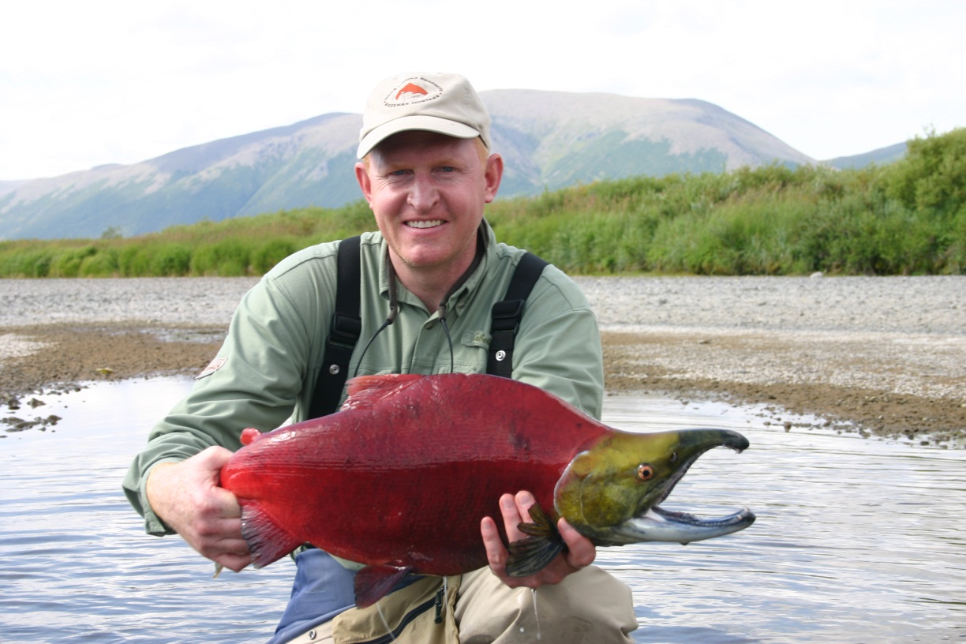
Ray-finned Fishes

Slide 12
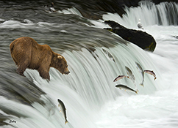
Fish Ecology
What is ecology?
Some fishes like salmon spend most of their lives in the ocean but migrate to fresh water to breed.
These fishes are called anadromous

Slide 13
Fish Ecology 2.0
Some fishes live in fresh water but migrate to the ocean to breed.
These fishes are catadromous ie eels

Slide 14
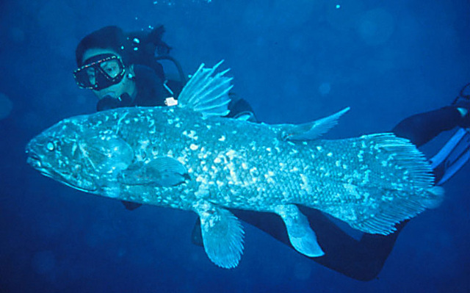
Lobe-finned Fishes
Only 7 living species
Fleshy fins – still have bones (big bones)
Some bones are jointed like the arms and legs of land vertebrates!!!!

Slide 15
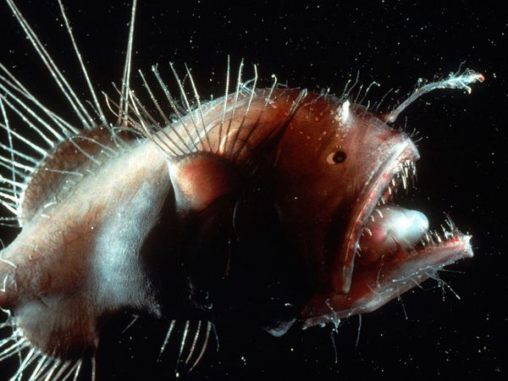
Survival Techniques - Feeding
Every mode of feeding is seen in fishes.
Some fishes will eat whatever is available at the time
Fishes have different adaptations to help them get their food

Slide 16
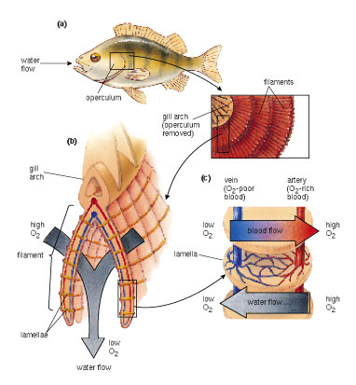
Survival Techniques - Respiration
What structure do fishes use for gas exchange?
What of the 4 structures that all chordates have did this structure evolve from?

Slide 17
Reproduction
Eggs are fertilized either externally or internally depending on the species.
Fishes whose eggs hatch outside the mother’s body are oviparous.
Ovoviviparous species keep eggs inside – eggs hatch and young is “born alive”
A few species including sharks are viviparous. What do you think that means?

