Slide 1
Class Reptilia

Slide 2
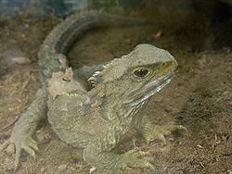
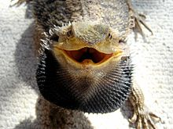
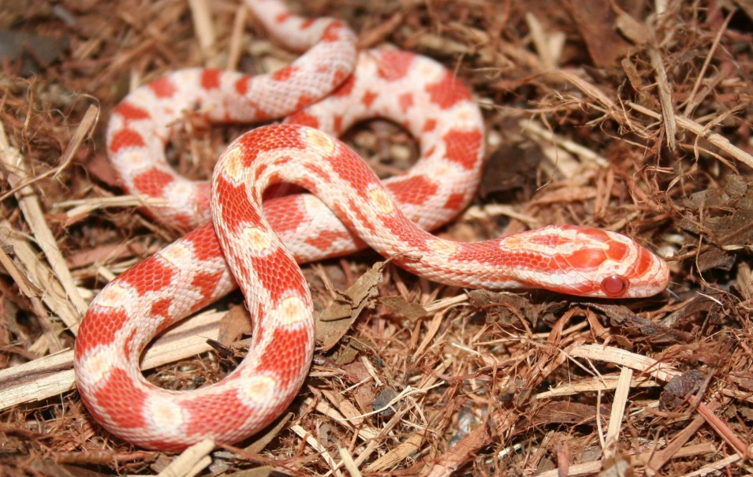
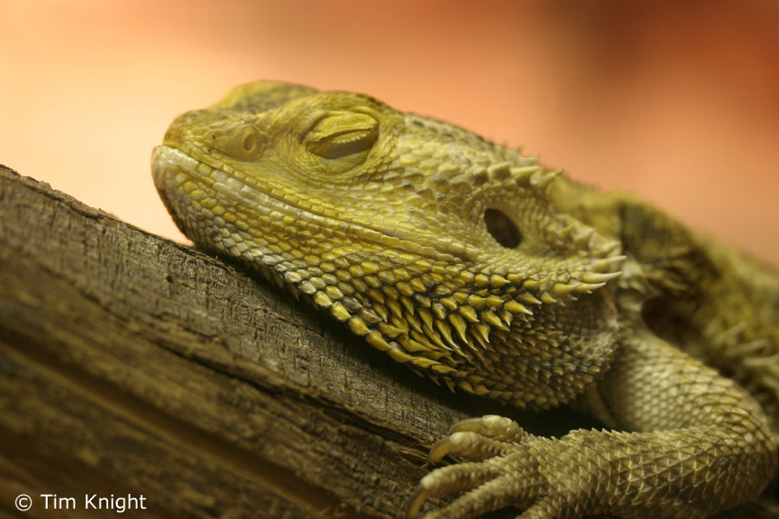
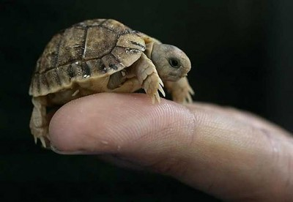

Slide 3
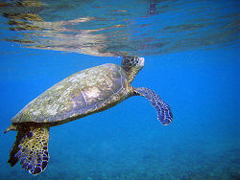
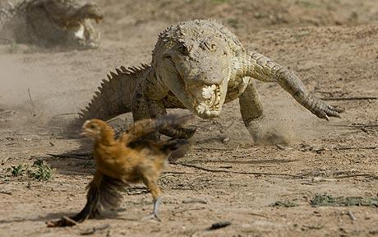
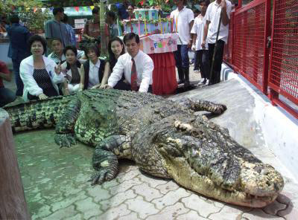
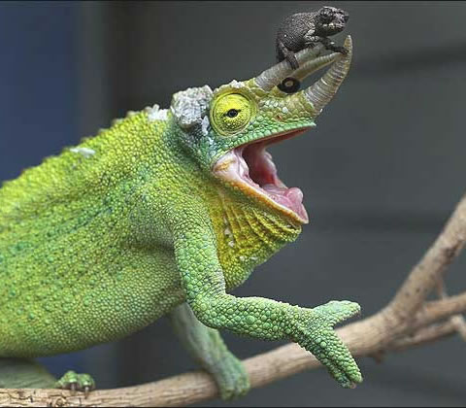
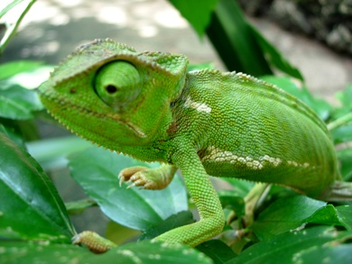

Slide 4
What is a Reptile?
A vertebrate
Has dry, scaly skin
Why would this be helpful?
Lungs
Terrestrial eggs with several membranes
What does terrestrial eggs mean?
How is that different from where amphibians lay their eggs?
Why would it be beneficial to have several membranes?

Slide 5
Where do Reptiles Live?
Reptiles live nearly everywhere on Earth except?
Why is that?

Slide 6
Body Temperature Control
All organisms thus far are ectotherms.
What does this mean?
What do organisms that are ectotherms do to help control their body temperature?

Slide 7
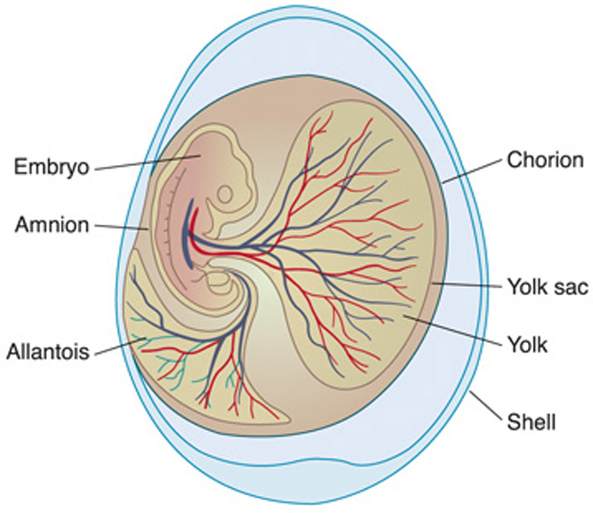
Reproduction
Internal fertilization
Most are oviparous – which means?
Some snakes and lizards are ovoviviparous – which means?
Have a special type of egg
Amniotic egg named for one of the 4 membranes surrounding the embryo

Slide 8
Groups of Reptiles
Lizards and Snakes
Crocodilians
Turtles and Tortoises
Tuataras

Slide 9
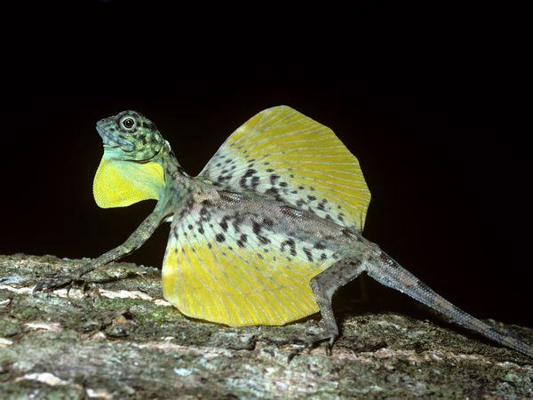
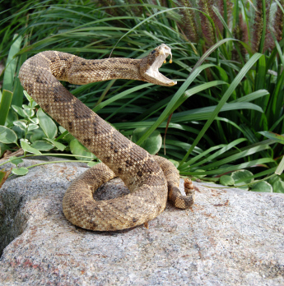
Lizards and Snakes – Order Squamata
Means “scaly reptiles”
Some lizards are highly specialized
Snakes have lost both pairs of legs during the course of evolution
Some snakes are so small they look like earthworms
Some can grow to more than 8 meters in length

Slide 10
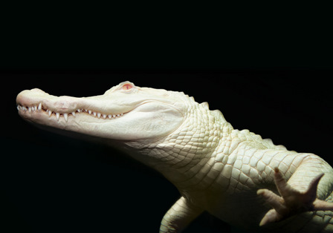
Crocodilians – Order Crocodilia
Fierce carnivores
Very protective of their young
Females guard eggs
Alligators only live in fresh water (N & S America)
Crocs elsewhere

Slide 11
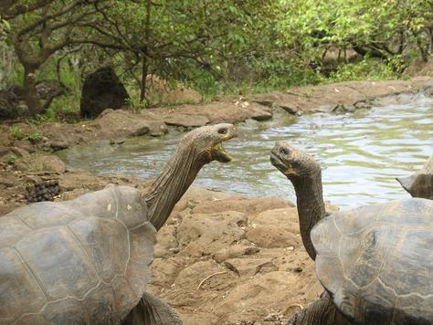
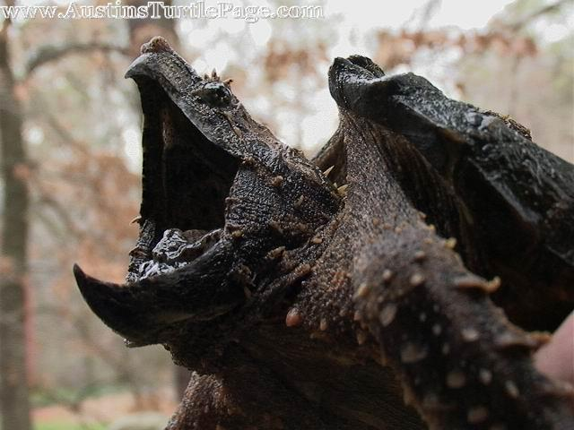
Turtles and Tortoises – Order Chelonia
Turtles typically live in the water
Tortoises typically live on land
Terrapin – turtle in salty water
Lack teeth – have bony jaw projections
Shell built into skeleton
Ventral – plastron
Dorsal – carapace

Slide 12
Tuataras – Order Rhynchocephalia
Only living survivor
“Beak headed” reptiles
Only found on islands off New Zealand
No external ears
Primitive scales
“third – eye” part of complex organ on top of brain (not much is known)

Slide 13
Response
Reptiles that are active during the day tend to have complex and can see color well
Many snakes have a good sense of smell
Most reptiles have receptor organs in the mouth to detect chemicals
Simple ears – have external eardrum
Snakes can pick up vibrations from the ground
Remember from the zoo – what specific type of vipers can detect the body heat of their prey?

