Slide 1
Class Aves

Slide 2
What animals are in class aves?
http://www.youtube.com/watch?v=omk6TAxJYOg

Slide 3
Questions
What domain?
What kingdom?
What phylum?
What subphylum?
What class?

Slide 4
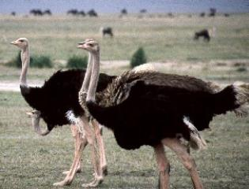
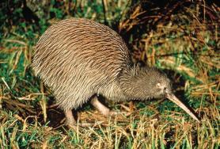
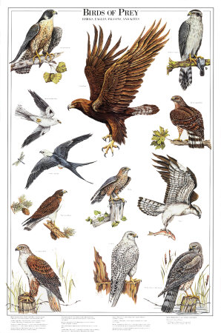
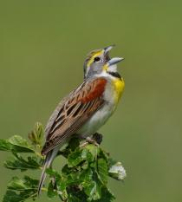
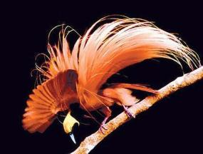
Birds

Slide 5
What Is a bird?
Reptilelike animals
Maintain a constant internal body temperature
Have feathers
2 legs modified for walking or perching
Front limbs modified into wings
What do most of these adaptations help accomplish?

Slide 6
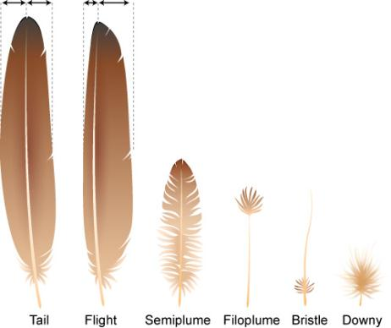
Feathers
Made of protein
Develop from pits in the bird’s skin
What do feathers help with?
2 types of feathers
Down feathers
Contour feathers

Slide 7
Feathers
What do birds do to take care of their feathers?
What is molting?

Slide 8
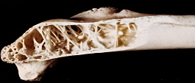
Bird Bones
What is special about bird bones?

Slide 9
Bird Orders
There are nearly 30 bird orders.
The largest group is the order passerines (perching birds)
Over 5000 species

Slide 10
Flocking Behavior
http://www.youtube.com/watch?v=eakKfY5aHmY

Slide 11
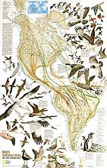
Migration in Birds
How do birds find direction in migration?

Slide 12
Bird Adaptations
https://docs.google.com/present/view?id=dfh23k67_1916cts9gkxb

