Slide 1
Chemistry

Slide 2
Periodic Table of Elements

Slide 3
Atoms
Very very small
Placed side by side, 100 million atoms would make a row only about 1 cm long (about the width of your pinkie)

Slide 4
Subatomic Particles
Protons +
Neutrons
Electrons –
Atomic mass = protons + neutrons

Slide 5
Isotopes
Atoms of the same element with a different mass
They have more neutrons
Radioactive Isotopes (unstable nucleus that breaks down over time)
Carbon 14
Carbon 12
Half life

Slide 6
Compounds
2 or more elements combined
ie water ☺
What is water made of?
When elements are combined they can be very different from how they are when they are solo

Slide 7
Chemical Bonds
This is what holds the atoms/elements in compounds
2 main kinds

Slide 8
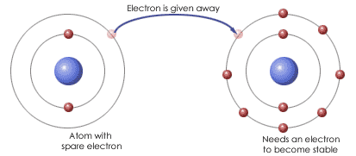
Ionic Bonds
This bond happens when 1 or more electrons are transferred (given) from one atom to another

Slide 9
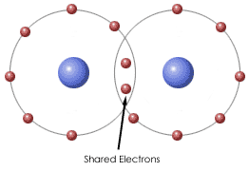
Covalent Bonds
This bond happens when electrons are shared by atoms

Slide 10
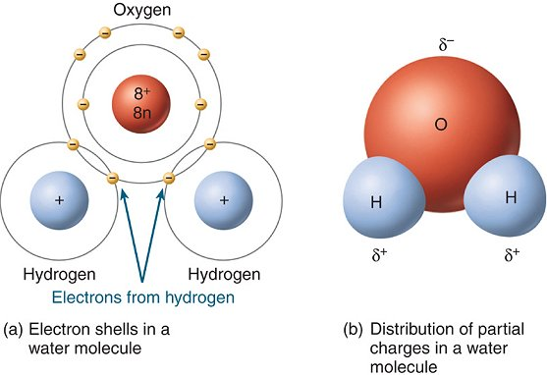
Molecule
The structure when atoms are joined by covalent bonds
Smallest unit of most compounds

Slide 11
Van der Waals Forces
When molecules are close together – a slight attraction can develop between regions of opposite charges on nearby molecules
http://www.youtube.com/watch?v=DOaoxzacLdE&feature=related
Climbing leopard gecko

