Slide 1
Cell Structure
Biology

Slide 2
Looking at cells
Cells vary greatly in size and shape
There are at least 200 types of cells
There are 100 trillion cells in the human body most range from 5-20 mm
Somatic Cells: Body Cells
Sex Cells: Reproductive Cells

Slide 3
Cell Size
http://learn.genetics.utah.edu/content/begin/cells/scale/

Slide 4
The Discovery of Cells
Most cells are too small to see with the naked eye
Microscope observations have led to the discovery of the basic characteristics of living things.

Slide 5
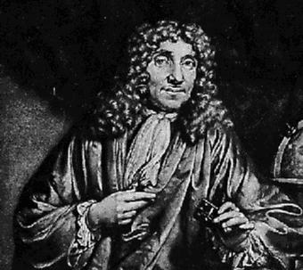
Cell History
Antony van Leeuwenhoek
Early 1600's
Developed the first microscope
First to see protists
Named protists -Wee Beasties

Slide 6
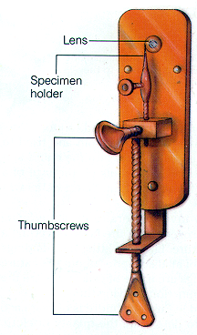
Leeuwenhoek’s First Microscope

Slide 7
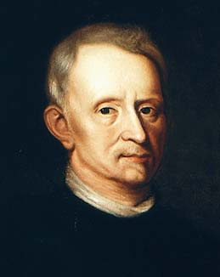
Cell History
Robert Hooke
1665
Looking at cork
Named cells

Slide 8
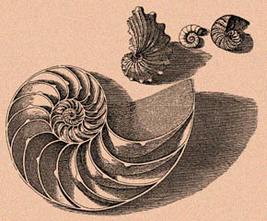
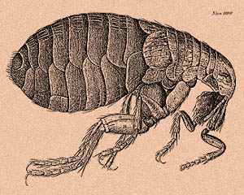
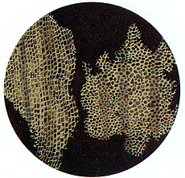
Robert Hooke’s Drawings

Slide 9
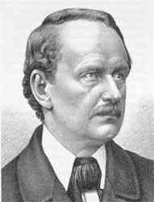
Cell History
Matthias Schleiden
1838
All plants are made of cells

Slide 10
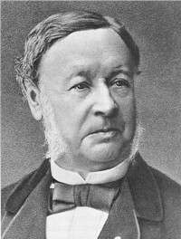
Cell History
Theodor Schwann
1839
All animals are made of cells

Slide 11
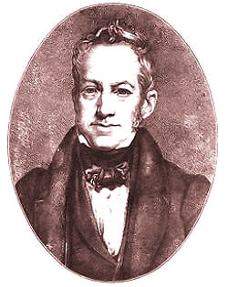
Cell History
Robert Brown
1840
Discovered cell nuclei in the epidermal cells of orchids
Named the nucleus or center

Slide 12
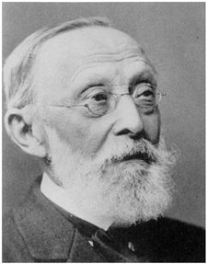
Cell History
Rudolph Virchow
1858
New cells come from old cells

Slide 13
Cell Theory
1. All living things are made of cells
2. Cells are the basic building block of life
3. New cells come from old cells
Cell theory was developed over hundreds of years and many scientists

Slide 14
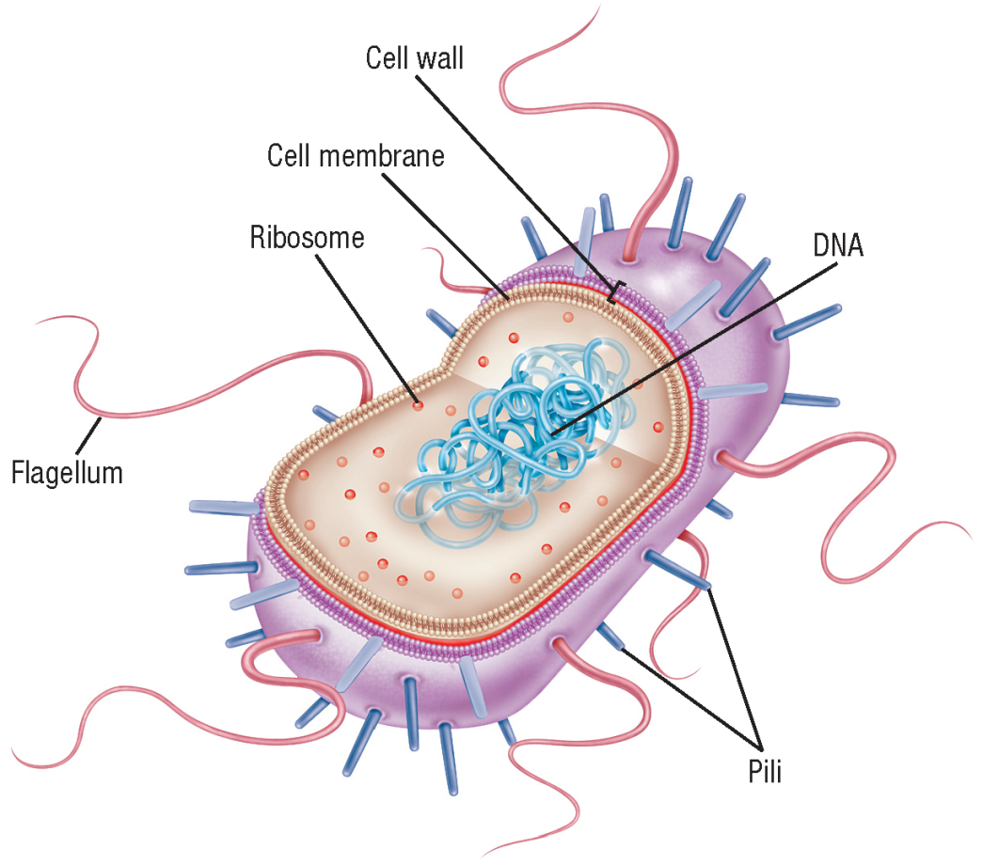
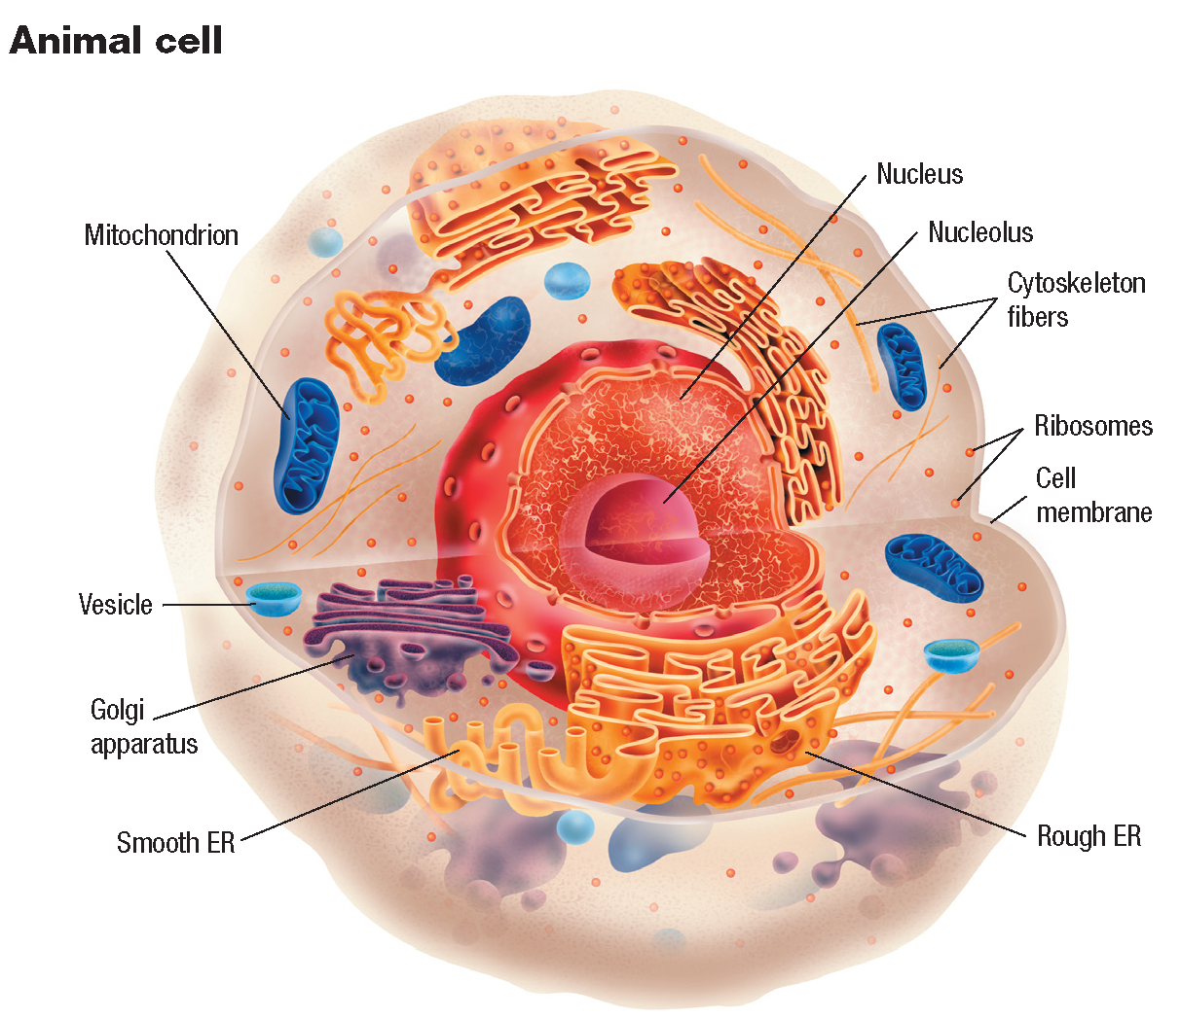
Prokaryotic and Eukaryotic Cells

