Slide 1
Biology Expectations

Slide 2
Attendance
Follow Hillcrest Policy – after 4 absences or tardies you have a no grade.
Unexcused absences – anything that is not cleared by the attendance office before you are gone.

Slide 3
What is on time?
Being in your seat, quietly working on your objective/bell ringer when the bell rings.
You are tardy if you are not in your seat when the bell rings.

Slide 4
What should you bring to Class?
Writing utensil and paper
Assignments that are due – you will NOT be excused to get your assignments

Slide 5
Grades
Test make-up (this is if you are absent)
You must come in and take the test as designated by the instructor.

Slide 6
Behavior
Show respect to teacher and peers.
Help maintain a positive learning environment.
Respect for property (personal and school).

Slide 7
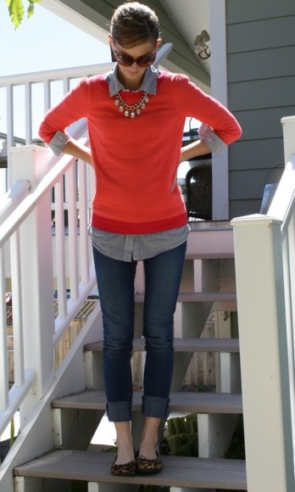
Dress Code
Wear clothes that cover you.
No hats or hoodies.

Slide 8
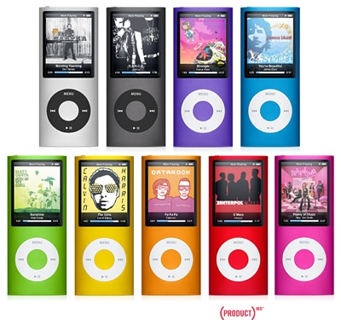
Electronic Devices
No electronic devices are to be seen.

Slide 9
Participation
This means that you are involved in class in a positive manner.

Slide 10
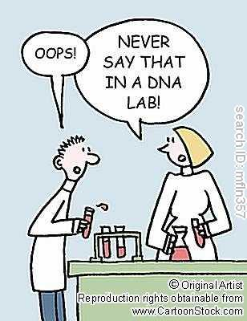
Labs
Read and follow directions given in lab.
Work with team members only.
Clean up ALL equipment and table.
Use common sense when handling chemicals.
Labs are fun, but that doesn’t mean you goof off.

