Slide 1
Properties of Water

Slide 2
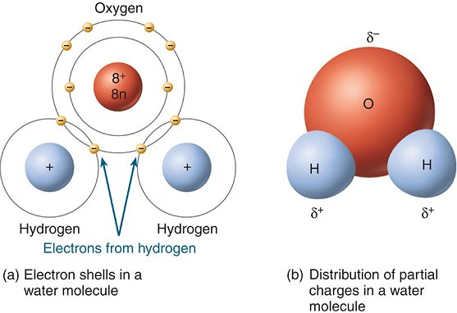
Polarity
The water molecule is neutral (like all molecules)
Water is polar because the oxygen atom is more “attractive” to electrons than hydrogen is

Slide 3
Hydrogen Bonds
Polar molecules attract each other
This is the bond between a hydrogen of one molecule and an oxygen of another molecule of water
Strongest of the bonds that can form between molecules (but not as strong as covalent or ionic)

Slide 4
Cohesion
An attraction between molecules of the same substance

Slide 5
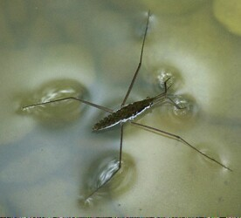
Surface Tension
Because of cohesion – water sticks together

Slide 6
Adhesion
An attraction between molecules of different substances

Slide 7
Capillary Action
Type of adhesion where water can rise in a narrow tube against the force of gravity.
Is one of the forces that draws water out of the roots of a plant and up into its stems and leaves

