Slide 1
Organic Molecules

Slide 2
What does organic mean?
Has carbon.

Slide 3
Why is carbon cool?
1. It can bond with many elements and make a strong covalent bond.
What happens to atoms in a covalent bond?
2. Carbon can bond to other carbon atoms. (it can make very long chains)

Slide 4
Macromolecules
Means “giant molecules”
Made by a process called polymerization

Slide 5
What is polymerization?
Making large compounds by hooking smaller ones together.
Monomers (smaller unit) join together to make polymers (large compound)

Slide 6
What are the 4 Macromolecules?
Carbohydrates
Lipids
Nucleic Acids
Proteins

Slide 7
Carbohydrates
Compounds made up of carbon, hydrogen, and oxygen atoms
1:2:1 ratio
Living things use carbohydrates as their main source of energy.
Plants and some animals also use carbohydrates for structural purposes.

Slide 8
Carbohydrates aka sugars
Single sugar molecules are also called monosaccharides
Large macromolecules formed from monosaccharides are called polysaccharides

Slide 9
Lipids
Generally not soluble in water (means it wont dissolve)
Used to store energy.

Slide 10
Lipids
Made of mostly carbon and hydrogen.
Common categories are: fats oils and waxes.

Slide 11
Lipid Formation
Many are formed when a glycerol molecule combines with a fatty acid

Slide 12
Saturated Fatty Acid
Only single bonds between carbons

Slide 13
Unsaturated Fatty Acid
Tend to be liquid at room temperature
Have at least one carbon-carbon double bond
Polyunsaturated

Slide 14
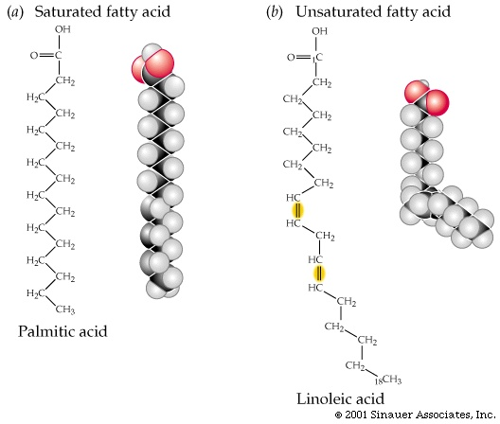
Saturated vs Unsaturated

Slide 15
Nucleic Acids
Have hydrogen, oxygen, nitrogen, carbon, and phosphorus
Store and transmit genetic information
2 kinds of nucleic acids:
Deoxyribonucleic acids (DNA)
Ribonucleic acids (RNA)

Slide 16
Nucleic Acids
Polymers made from monomers - nucleotides

Slide 17
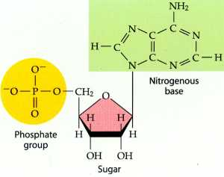
Nucleotides
Made of 3 parts:
1. a 5-carbon sugar
2. a phosphate group
3. a nitrogenous base

Slide 18
Proteins
Have nitrogen, carbon, hydrogen, and oxygen.
Polymers of molecules called amino acids.

Slide 19
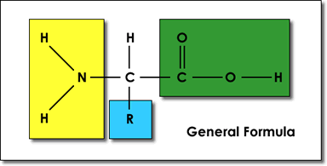
Amino Acids
Compounds with an amino group (-NH2) and a carboxyl group (-COOH)
More than 20 in nature

Slide 20
R Group
This is the part of the amino acid that is different. They could be:
Acidic
Basic
Polar
Nonpolar
Have a carbon ring

Slide 21
Protein Roles
Every protein has a specific role
Control the rate of reactions
Regulate cell processes
Structural purposes
Transport substances
Help fight diseases

Slide 22
Protein Organization
Primary (1º) amino acid sequence
Secondary (2º) amino acids within chain folded or twisted
Alpha helix
Beta sheet
Tertiary (3º) amino acid chain folded
Quaternary (4º) 3D structure

Slide 23
How do proteins stay together?
Hydrogen bonds
Van der Waals forces

