Slide 1
Midwater/Deep Ocean

Slide 2
What is the Midwater?
Aka the Twilight world
Mesopelagic Zone
Upper part has dim light during the day
200 m to about 1,00 m deep in the ocean is the mid ocean
Temperature ranges drastically (~2 ºC to 22 ºC)

Slide 3
Adaptations of Midwater Animals
Food is not abundant so the fish are quite small
Large mouths
Broad diets
Tubular eyes
Countershading/Transparency
Photophores
Bioluminescence
Advanced gills

Slide 4
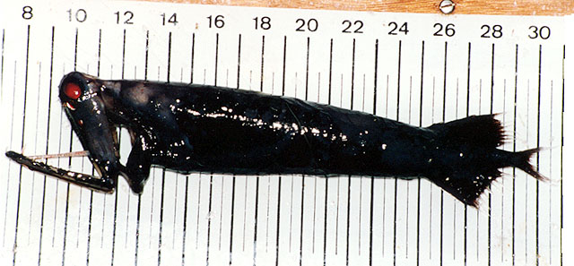
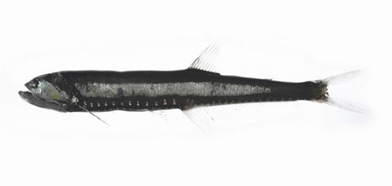
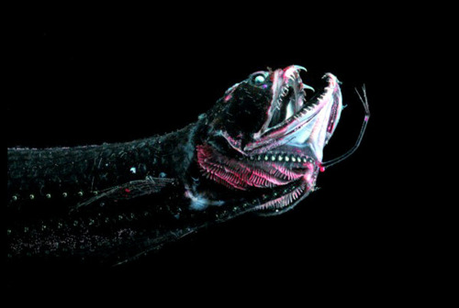
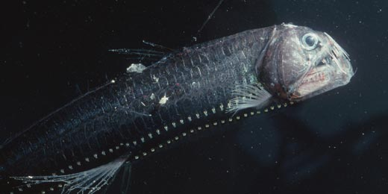
Typical Midwater Fish

Slide 5
What is the deep sea?
Depths below 1,000 m (3,280 ft or 0.6 mi)
NO light – Completely dark
Super cold 1 to 2 ºC (35 ºF)
Very little food

Slide 6
Adaptations of Deep Sea Animals
Sluggish
Weak Skeletons
No Scales
Poor Muscles
No Swim Bladder
Hermaphrodites/Male Parasitism

Slide 7
Weird Animals
http://ocean.nationalgeographic.com/ocean/photos/deep-sea-creatures/#/deep-sea01-frill-shark_18161_600x450.jpg

