Slide 1
Class Amphibia

Slide 2
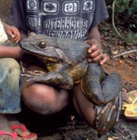
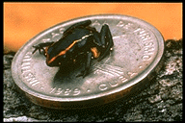
What is an Amphibian?
Vertebrate
Lives in water as a larva
Lives on land as an adult

Slide 3
Questions
What domain?
What kingdom?
What phylum?
What subphylum?
What class?

Slide 4
What is an Amphibian?
Breathes with lungs as an adult
What do they use as larva?
Has moist skin with mucus glands
Why are mucus glands so important?
Lacks scales and claws

Slide 5
Amphibian Evolution
1st amphibians probably resembled lobe-finned fishes – however the amphibians had legs
What class are lobe-finned fishes in?
What are some issues with coming out of the water to live?

Slide 6
Issues with Terrestrial Life
What does terrestrial life mean?
Breathe air
Keep themselves from drying out
Also eggs from drying out
Support themselves from gravity
Protection from sun

Slide 7
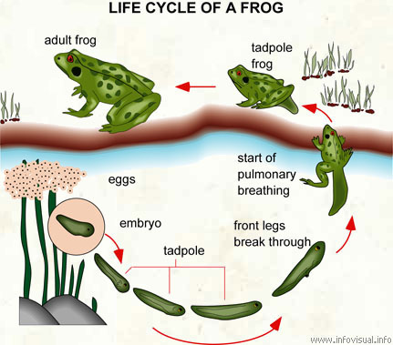

Slide 8
Amphibian Adaptations
Bones in limbs and limb girdles became stronger
What would this help with?
Lungs allowed them to breathe air
The sternum formed a bony shield to support/protect internal organs.

Slide 9
Amphibian Evolution
After these characteristics evolved amphibians were the dominant life form (360-286 million years ago)
Climate change took away their habitat
Why is climate change an issue?

Slide 10
Modern Amphibians
Only 3 orders of small amphibians survive
Urodela
Anura
Apoda

Slide 11
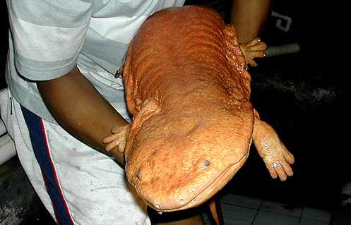
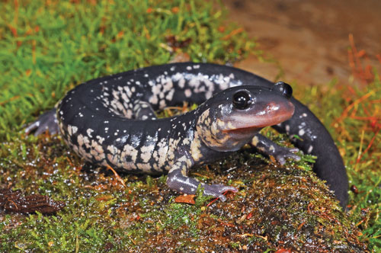
Urodela – Salamanders & Newts
Both adults and larvae are carnivores
Usually live in moist woods
Some keep their gills their whole lives
Long tail
Two pairs of limbs
Lack middle ear

Slide 12
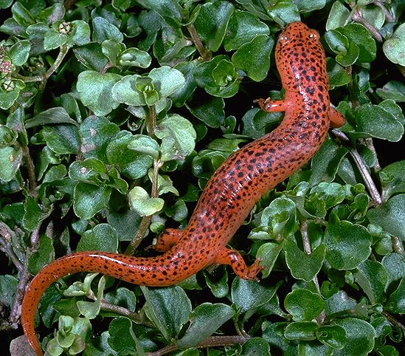
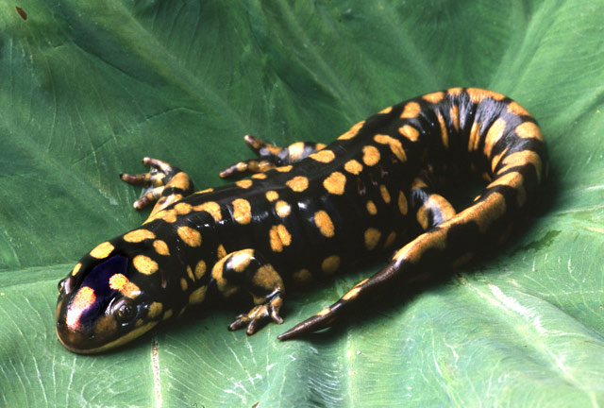
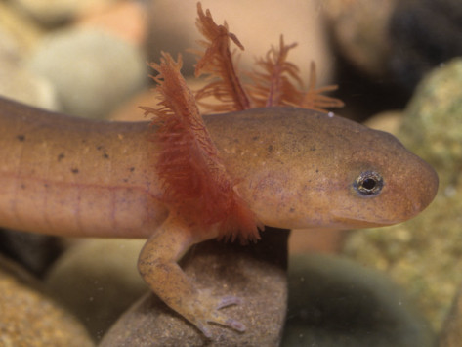

Slide 13
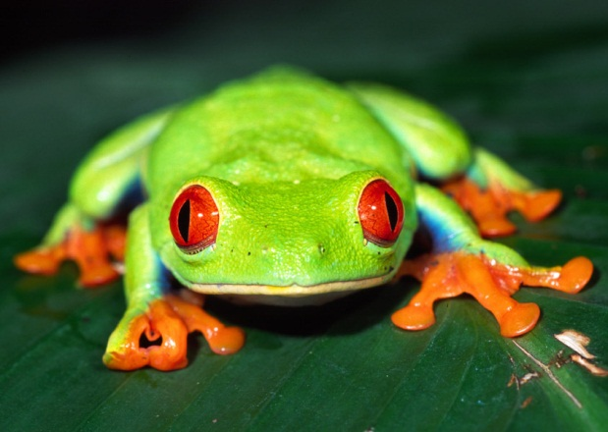
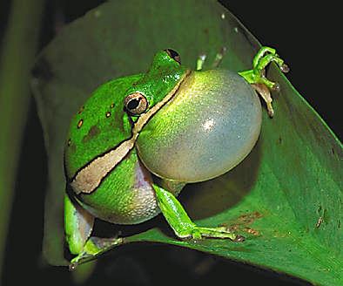
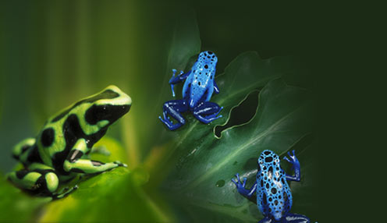
Anura – Frogs and Toads
Frogs make long jumps (long legs)
Frogs are more closely tied to water than toads

Slide 14
Anura – Frogs & Toads
Tailless
Tympanum and larynx well developed

Slide 15
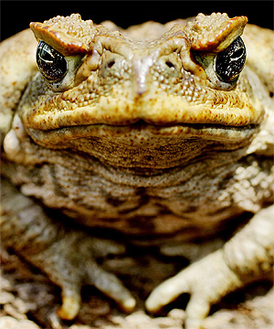
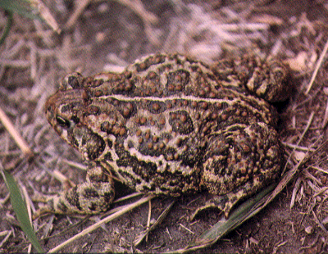
Anura – Frogs and Toads
Toads make short hops (short legs)

Slide 16
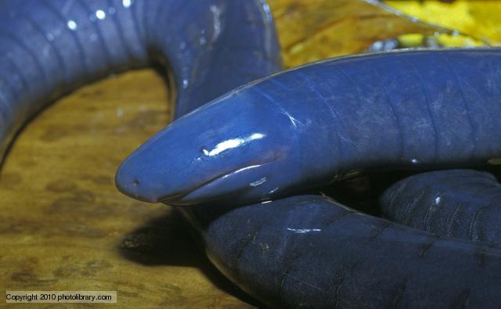
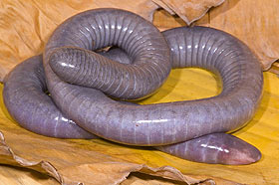
Apoda - Caecilians
Legless
Live in water or burrow in moist soil
Many have fishlike scales

Slide 17
Respiration in Amphibians
Larval amphibians – gas exchange through skin as well as gills
Adult amphibians – use their lungs – and do some through their skin because it is moist

Slide 18
Ecology of Amphibians
Because they don’t have much protection from predators like scales, fur, and feathers – they have some cool adaptations
Some amphibians release toxins

