Slide 1
Section 2 Inside the Eukaryotic Cells
Biology

Slide 2
Cell Wall
Function:
Support & protection for plant cells
City Wall
The activities that occur in the cell are sometimes compared with those of a city.
If you think of a Cell like a city, you will have a much easier time learning about the inside of cell.

Slide 3
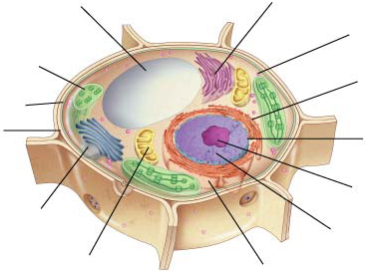
Figure 7-5 Plant and Animal Cells
Section 7-2
Vacuole
Smooth endoplasmic
reticulum
Ribosome
(free)
Chloroplast
Ribosome
(attached)
Cell
Membrane
Cell wall
Nuclear
envelope
Nucleolus
Golgi apparatus
Nucleus
Mitochondrian
Rough endoplasmic reticulum
Plant Cell
Go to Section:

Slide 4
Cell Membrane
Selectively permeable
Allows certain things in and out of the cell (Gate-keeper for the cell).
City Gate

Slide 5
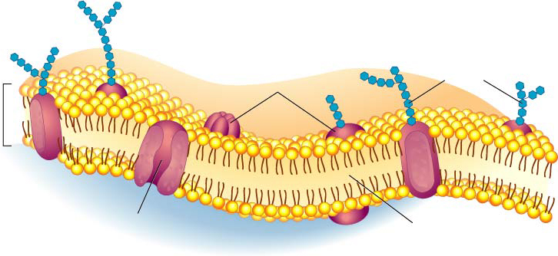
Figure 7-15 The Structure of the Cell Membrane
Section 7-3
Outside
of cell
Carbohydrate
chains
Proteins
Cell
membrane
Inside
of cell
(cytoplasm)
Protein
channel
Lipid bilayer
Go to Section:

Slide 6
Ribosome
Protein factory of the cells
Found on the endoplasmic reticulum and free floating in the cytoplasm
Construction Site

Slide 7
Figure 7-5 Plant and Animal Cells
Section 7-2
Vacuole
Smooth endoplasmic
reticulum
Ribosome
(free)
Chloroplast
Ribosome
(attached)
Cell
Membrane
Cell wall
Nuclear
envelope
Nucleolus
Golgi apparatus
Nucleus
Mitochondrian
Rough endoplasmic reticulum
Plant Cell
Go to Section:

Slide 8
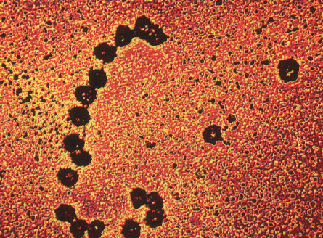
Ribosome

Slide 9
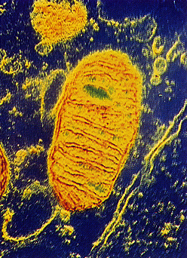
Mitochondrion
The power house of cell
Makes ATP (cell energy) for the cell
City Power

Slide 10
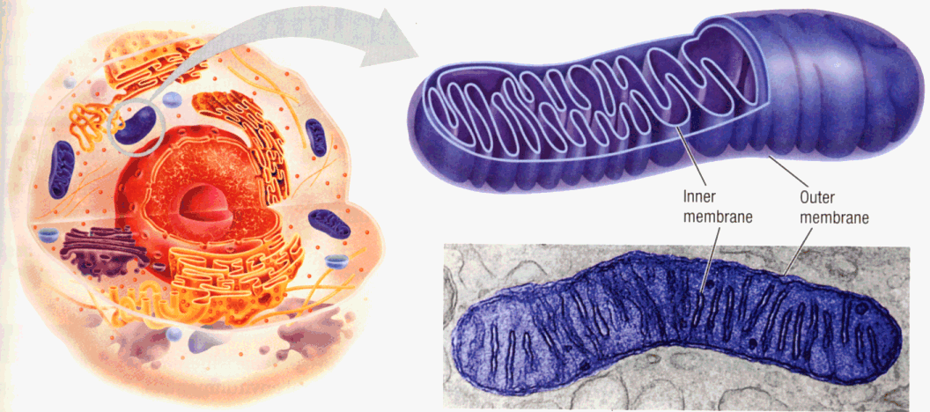
Mitochondrion

Slide 11
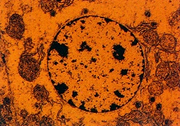
Nucleus
Command center of the cell
Surrounded by a membrane
Contains DNA and RNA
City Hall

Slide 12
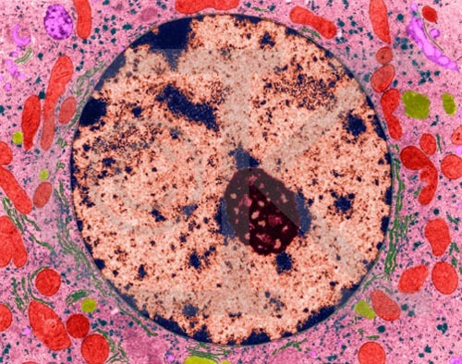
Nucleolus
Is found inside nucleus
Made of RNA
Mayor

Slide 13
Figure 7-5 Plant and Animal Cells
Section 7-2
Vacuole
Smooth endoplasmic
reticulum
Ribosome
(free)
Chloroplast
Ribosome
(attached)
Cell
Membrane
Cell wall
Nuclear
envelope
Nucleolus
Golgi apparatus
Nucleus
Mitochondrian
Rough endoplasmic reticulum
Plant Cell
Go to Section:

Slide 14
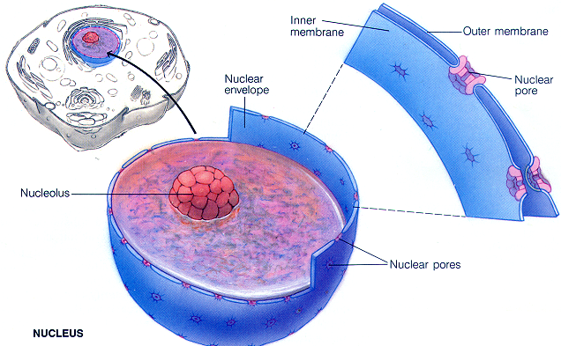
Nucleus and Nucleolus

Slide 15
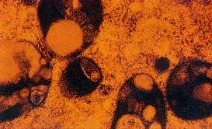
Lysosome
Produces digestive enzymes for the cell
Moves garbage out of cell
Waste Disposal

Slide 16
Golgi Apparatus
Packages protein for export out of the cell
Post Office

Slide 17
Figure 7-5 Plant and Animal Cells
Section 7-2
Vacuole
Smooth endoplasmic
reticulum
Ribosome
(free)
Chloroplast
Ribosome
(attached)
Cell
Membrane
Cell wall
Nuclear
envelope
Nucleolus
Golgi apparatus
Nucleus
Mitochondrian
Rough endoplasmic reticulum
Plant Cell
Go to Section:

Slide 18
Endoplasmic Reticulum (ER)
Description:
Membrane system
Rough = ribosomes
Smooth = no ribosomes
Function:
Cell membrane is assembled - synthesis of lipids (smooth)
Proteins are modified or assembled (rough)
Roads and Streets

Slide 19
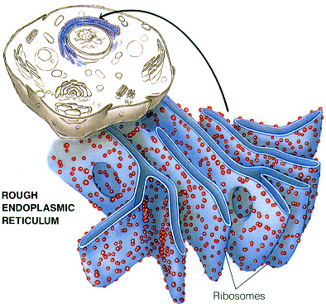
Endoplasmic Reticulum

Slide 20
Figure 7-5 Plant and Animal Cells
Section 7-2
Vacuole
Smooth endoplasmic
reticulum
Ribosome
(free)
Chloroplast
Ribosome
(attached)
Cell
Membrane
Cell wall
Nuclear
envelope
Nucleolus
Golgi apparatus
Nucleus
Mitochondrian
Rough endoplasmic reticulum
Plant Cell
Go to Section:

Slide 21
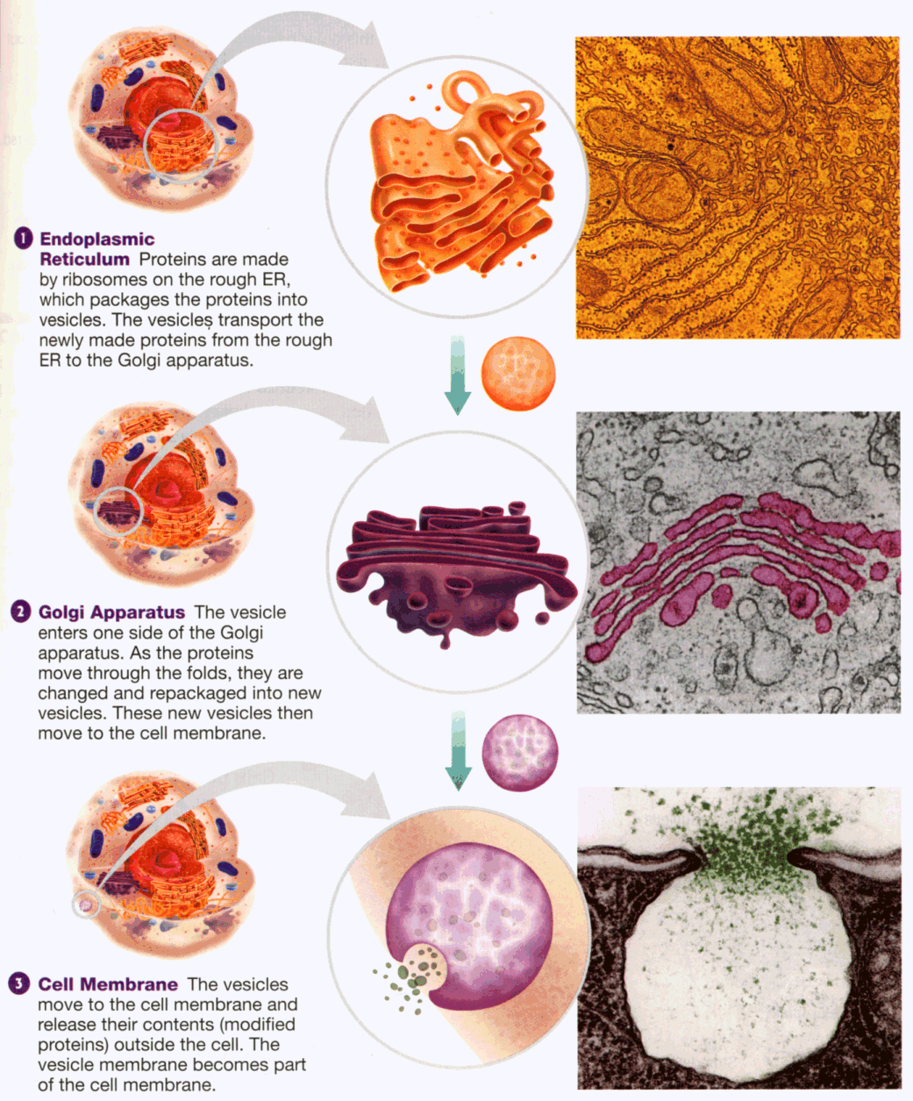
ER, Golgi and Protein Export

Slide 22
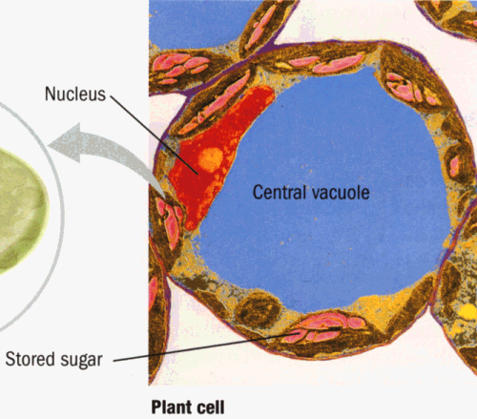
Vacuoles
Storage (water, garbage, etc)
Supports the cell wall in plants
Digestion
City Lake

Slide 23
Figure 7-5 Plant and Animal Cells
Section 7-2
Vacuole
Smooth endoplasmic
reticulum
Ribosome
(free)
Chloroplast
Ribosome
(attached)
Cell
Membrane
Cell wall
Nuclear
envelope
Nucleolus
Golgi apparatus
Nucleus
Mitochondrian
Rough endoplasmic reticulum
Plant Cell
Go to Section:

Slide 24
Chloroplast
Place for photosynthesis, green color and has DNA
Sugar Company

Slide 25
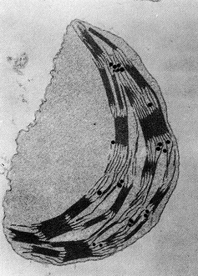
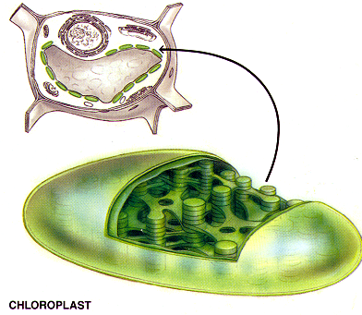
Chloroplast

Slide 26
Figure 7-5 Plant and Animal Cells
Section 7-2
Vacuole
Smooth endoplasmic
reticulum
Ribosome
(free)
Chloroplast
Ribosome
(attached)
Cell
Membrane
Cell wall
Nuclear
envelope
Nucleolus
Golgi apparatus
Nucleus
Mitochondrian
Rough endoplasmic reticulum
Plant Cell
Go to Section:

Slide 27
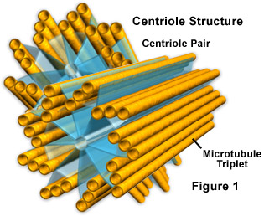
Microtubule
Network of long protein strands
Gives structure to the cell
Found in animal cells only

