Slide 1
Log on computer
Go to:
www.turnitin.com

Slide 2
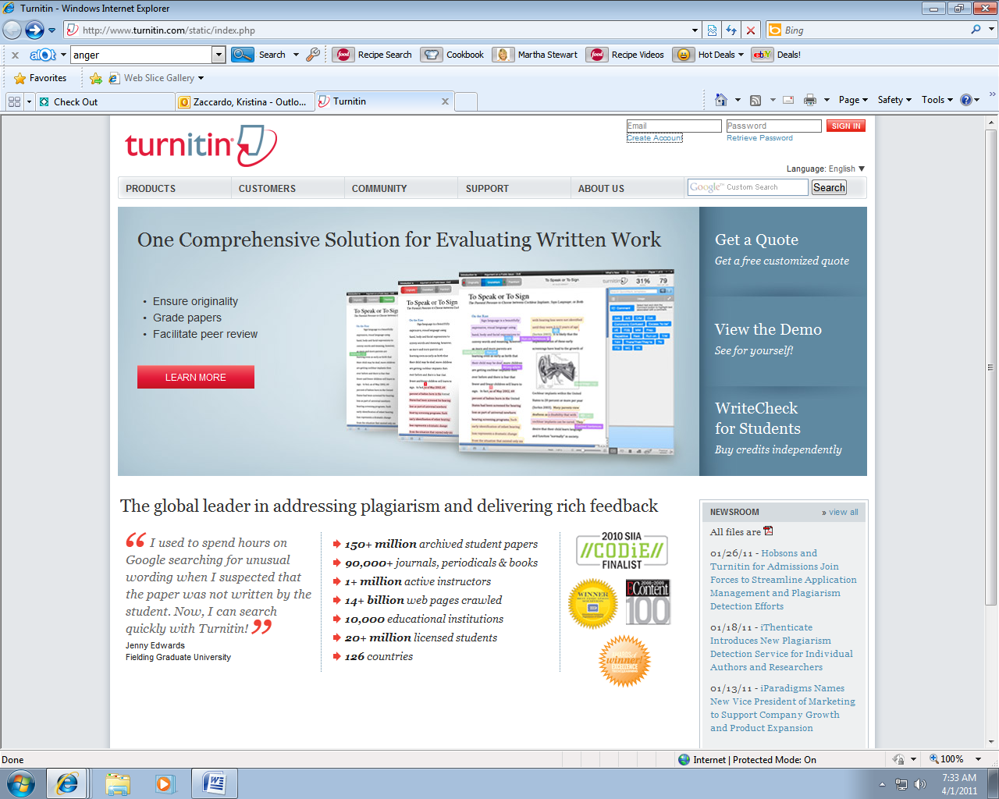

Slide 3
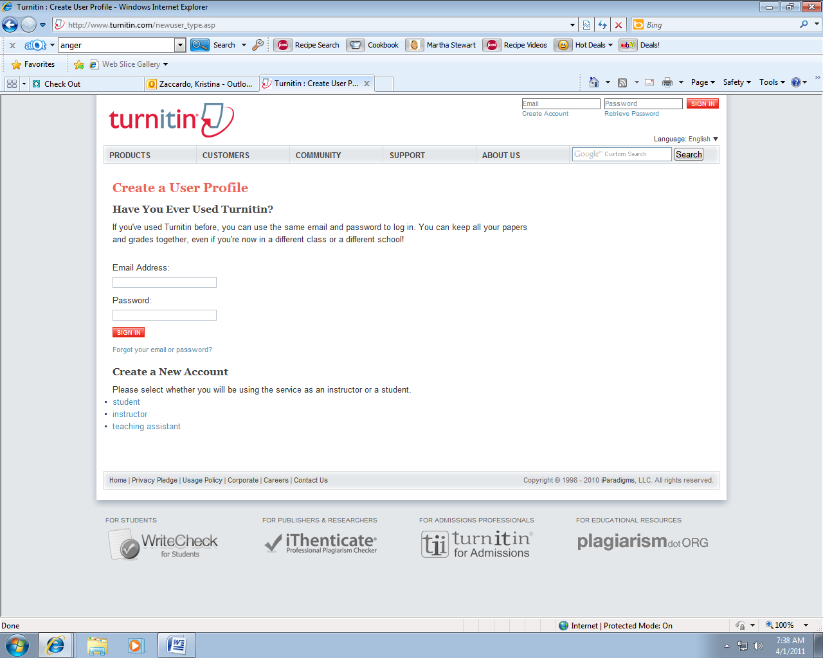

Slide 4
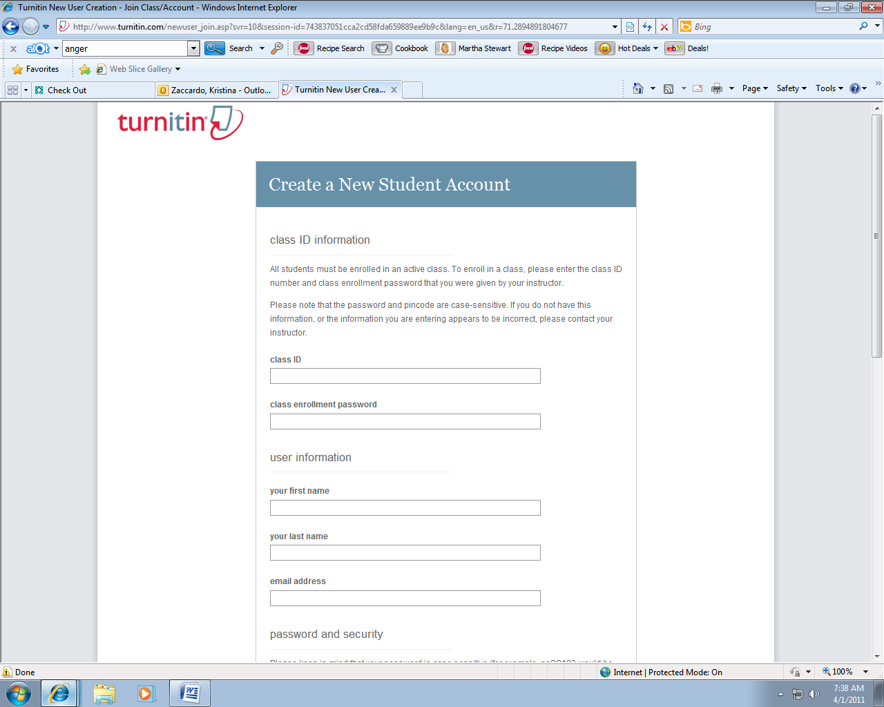
Class ID =
7069225
Password = marine8
Notes:
Mon –
5789390
zoo6

Slide 5
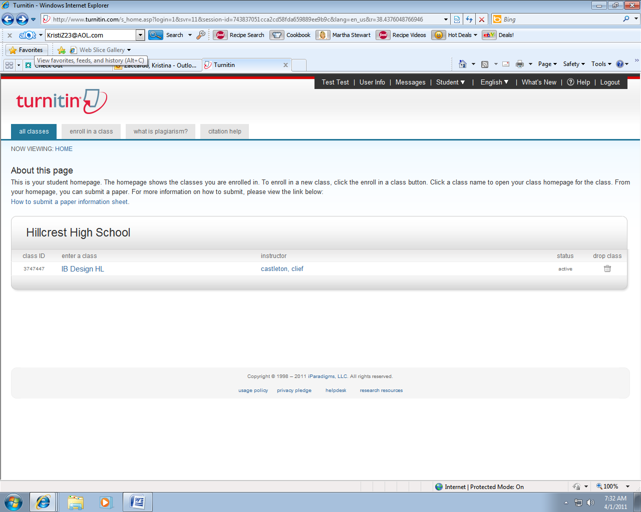

Slide 6
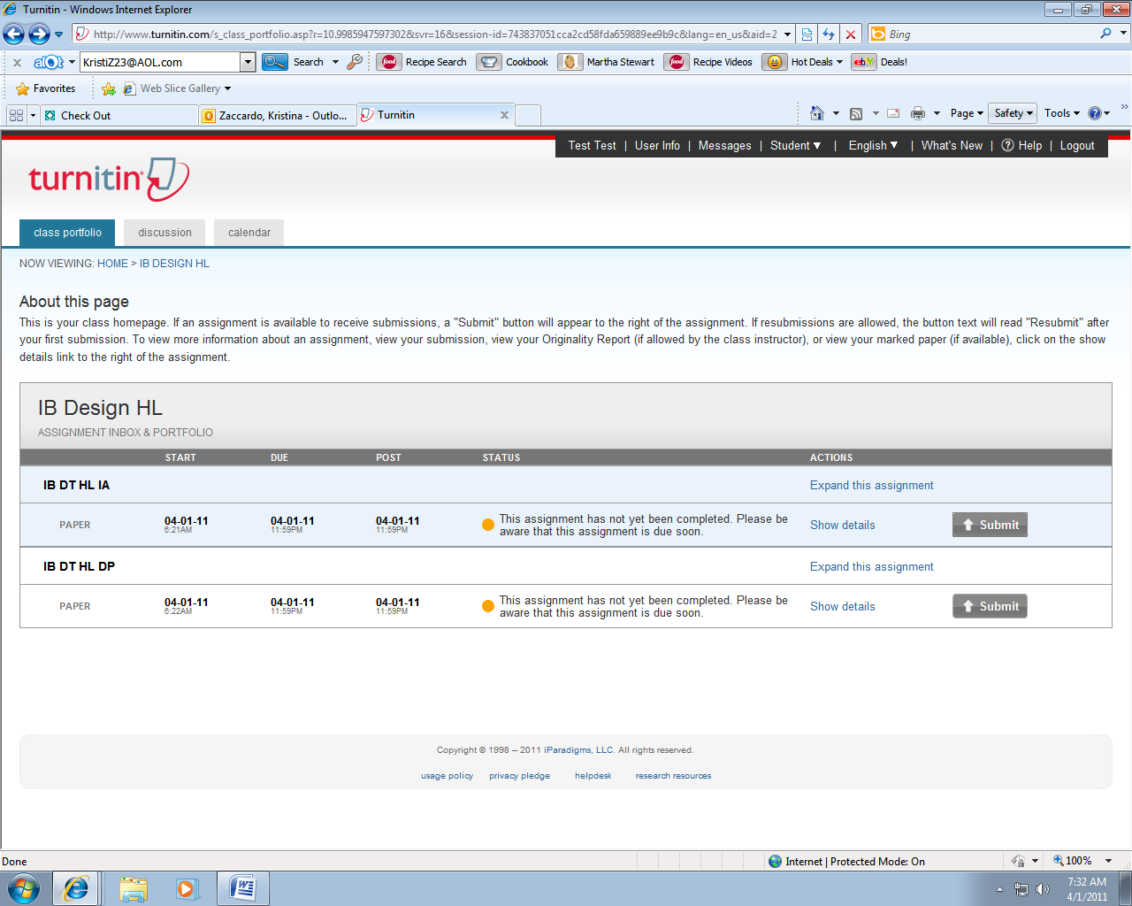

Slide 7
